Slide 1
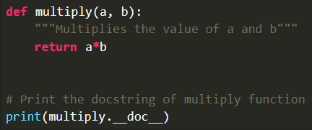


Basic
형식 모음
글자
Comment Single line comment( # ) Multiline comment( Multi # ) String literal( single (‘comment script') / ( “”” )) → python ignore string literals that aren’t assign to variable(So, can use comment) like ‘hello’ Docstring comment( “”” ) → Using triple quotes(“””) → Docstring appears right after function, class, module like def func1: ... , “comment is ...”, print(func1.__doc__) → Using __doc__ attribute, can print comment of function, module, class → For reading and distinguish from letter literals, docstring should start capital letter and end with . → If using help(), get information about description of function → It’s good to involve description about function operation, parameter, return value, attribute → Print docstring: print(function_name.__doc__) or help(function_name) Multiple Line Statement Using \ in end of statement like a = 1 + 2 + 3 + \ 4 + 5 + 6 Using “”” or ‘’’ for multiple line string
메인 내용
코드
(x₁, y₁)
(x₂, y₂)
(x_{m}, y_{m})
Result
Inside first_space
Ctrl+ = ➔ 아래첨자 Ctrl + shift + = ➔ 윗첨자 Ctrl + space ➔ 복구 Shift + f3 ➔ 대소문자 변경
예시 표시
Partition
그림 설명
예시
Code
예시
code
Mismatch
글자설명
Pattern
(-2,-2) | (-2,-1) | (-2,0) | (-2,1) | (-2,2)
(-1,-2) | (-1,-1) | (-1,0) | (-1,1) | (-1,2)
(0,-2) | (0,-1) | (x,y) | (0,1) | (0,2)
(1,-2) | (1,-1) | (1,0) | (1,1) | (1,2)
(2,-2) | (2,-1) | (2,0) | (2,1) | (2,2)
Notes:
https://www.geeksforgeeks.org/python-comments/
https://www.geeksforgeeks.org/python-syntax/

Slide 2
Keyword
형식 모음
글자
Keyword Reserved word that can’t be used as variable, function, class’s name Using keyword.kwlist, import keyword, get all keyword name None → Special constant(null value or void) → Can’t create multiple None objects → None isn’t equal 0 or empty list like print(None == 0), print(None == []) ➔ False, False → True + True + True = 3 (True: 1, False: 0) like print(False == 0), print(True == 1) ➔ True, True and(logical operator) → If and operation result is False, return first false value Ex) 3 and 0 ➔ return 0 → If and operation result is True, return last true value Ex) 3 and 10 ➔ return 10 or(logical operator) → If or operation result is False, return last false value Ex) 0 or 0 ➔ return 0 → If or operation result is True, return first true value Ex) 10 or 20 or 30 ➔ return 10 is → Check if both objects take same memory → Result is True: ‘’(empty string), ()(empty tuple), (()), (‘’)(nested empty) → Result is False: {}(empty dictionary), [](empty list), [()], [{}], [[]], [‘’], ([]), ({}), {‘’} (nested empty) with → To wrap execution of block of code within method as → To create alias for module imported like import math as hello pass → null statement → To prevent indentation errors and used as placeholder
메인 내용
코드
(x₁, y₁)
(x₂, y₂)
(x_{m}, y_{m})
Result
Inside first_space
Ctrl+ = ➔ 아래첨자 Ctrl + shift + = ➔ 윗첨자 Ctrl + space ➔ 복구 Shift + f3 ➔ 대소문자 변경
예시 표시
Partition
그림 설명
예시
Code
예시
code
Mismatch
글자설명
Pattern
(-2,-2) | (-2,-1) | (-2,0) | (-2,1) | (-2,2)
(-1,-2) | (-1,-1) | (-1,0) | (-1,1) | (-1,2)
(0,-2) | (0,-1) | (x,y) | (0,1) | (0,2)
(1,-2) | (1,-1) | (1,0) | (1,1) | (1,2)
(2,-2) | (2,-1) | (2,0) | (2,1) | (2,2)
Notes:
https://www.geeksforgeeks.org/python-keywords/

Slide 3
Underscore
형식 모음
글자
Underscore Single Underscore → Single underscore in interpreter - Return last value executed expression value in prompt/interpreter - Ex) >> a = 10, b = 20 >> a+b 30 >> _ * 2 60 → Single underscore for ignoring value - Don’t want to assign value - Assignment to underscore doesn’t executed, Underscore have last value - Ex) for _ in range(10) print(“hello”) a, b, _, _ = method1(var1) → Single underscore after name - To avoid conflict with keyword and variable name → Single underscore before name - non-public(protected) variable/function/method - If specified in __all__, can call(weak Private) → Single underscore in numeric literals - Used as visual separator for digit grouping to boost readability - Ex) a = 10_000_000.0 b = 0xCAFE_F00D c = 0b_0011_1111_0100_1110 Double Underscore → Double underscore before name - tells interpreter to rewrite name in order to avoid conflict in subclass - __valName == obj._className__valName → Double underscore before and after name - To use as operator overloading - To differentiate between user-defined function and module’s function
메인 내용
코드
(x₁, y₁)
(x₂, y₂)
(x_{m}, y_{m})
Result
Inside first_space
Ctrl+ = ➔ 아래첨자 Ctrl + shift + = ➔ 윗첨자 Ctrl + space ➔ 복구 Shift + f3 ➔ 대소문자 변경
예시 표시
Partition
그림 설명
예시
Code
예시
code
Mismatch
글자설명
Pattern
(-2,-2) | (-2,-1) | (-2,0) | (-2,1) | (-2,2)
(-1,-2) | (-1,-1) | (-1,0) | (-1,1) | (-1,2)
(0,-2) | (0,-1) | (x,y) | (0,1) | (0,2)
(1,-2) | (1,-1) | (1,0) | (1,1) | (1,2)
(2,-2) | (2,-1) | (2,0) | (2,1) | (2,2)
Notes:
https://www.geeksforgeeks.org/underscore-_-python/

Slide 4
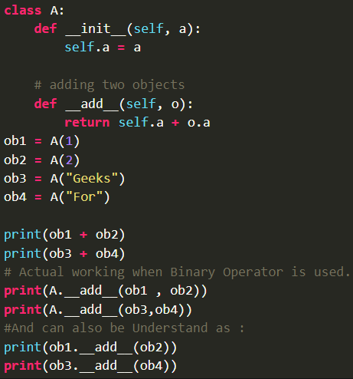

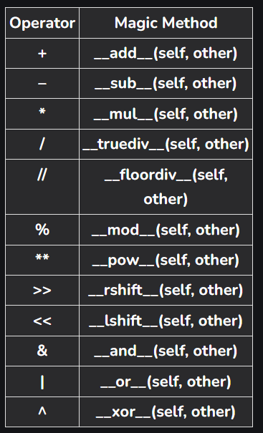
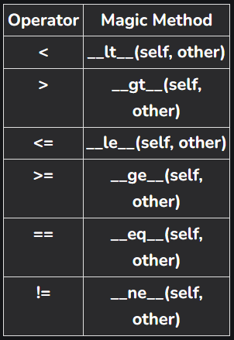
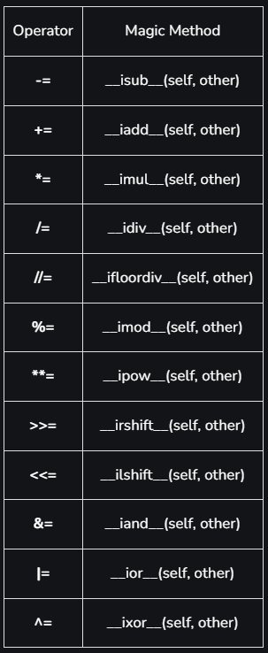
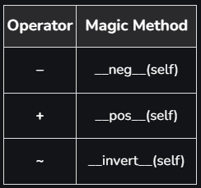
Operator Overloading
형식 모음
글자
Operator Overloading Giving extended meaning beyond predefined operational meaning Shows different behavior for objects of different classes Can overload all existing operators, but can’t create new operator Special function or magic function is automatically invoked like __add__ when using + operator For operator overloading, must redefine special function or magic function Can overload boolean operator(and, or, not) by __and__, __or__, __not__
메인 내용
코드
(x₁, y₁)
(x₂, y₂)
(x_{m}, y_{m})
Result
Inside first_space
Ctrl+ = ➔ 아래첨자 Ctrl + shift + = ➔ 윗첨자 Ctrl + space ➔ 복구 Shift + f3 ➔ 대소문자 변경
예시 표시
Partition
그림 설명
예시
Code
예시
code
Mismatch
글자설명
Pattern
(-2,-2) | (-2,-1) | (-2,0) | (-2,1) | (-2,2)
(-1,-2) | (-1,-1) | (-1,0) | (-1,1) | (-1,2)
(0,-2) | (0,-1) | (x,y) | (0,1) | (0,2)
(1,-2) | (1,-1) | (1,0) | (1,1) | (1,2)
(2,-2) | (2,-1) | (2,0) | (2,1) | (2,2)
Notes:
https://www.geeksforgeeks.org/operator-overloading-in-python/

Slide 5
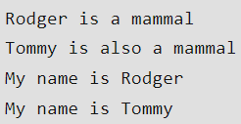
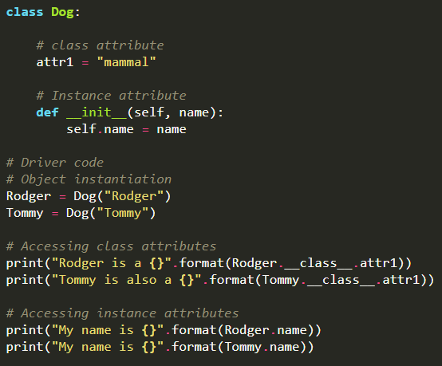
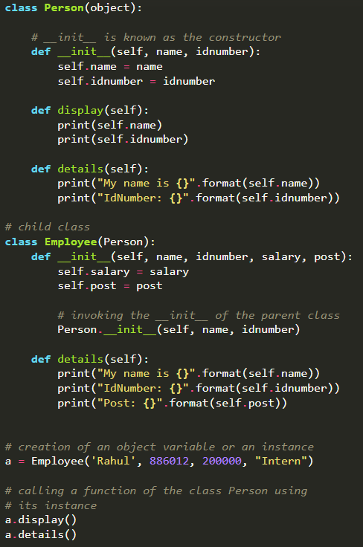
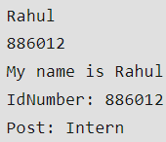
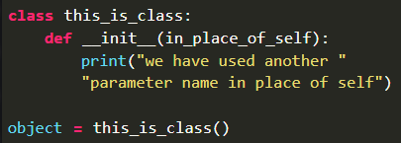
OOP Concept
형식 모음
글자
Object Oriented Programming Concept Concept → Class - Logical entity that contains attribute(public variable) and method - For access attribute, use dot operator → Object - Consists of state(attribute), behavior(method), identity(unique name) → Polymorphism - Having many forms using overriding → Encapsulation - Wrapping data and method that work on data with one unit → Inheritance - parent class(base class), child class(derived class) - Provide reusability of code - Type - Single Inheritance - Multilevel Inheritance: a derived class to inherit properties from immediate parent class which in turn inherits properties from his parent class - Hierarchical inheritance: more than one derived class to inherit properties from a parent class - Multiple Inheritance: one derived class to inherit properties from more than one base class → Data Abstraction - Hide unnecessary code details from user - Achieved by creating abstract class ※ self Pointer to current object(not keyword) Instance of class First parameter of instance method and constructor To modify object’s properties and execute tasks Can use another parameter name in place of self(but using self increases readability of code)
메인 내용
코드
(x₁, y₁)
(x₂, y₂)
(x_{m}, y_{m})
Result
Inside first_space
Ctrl+ = ➔ 아래첨자 Ctrl + shift + = ➔ 윗첨자 Ctrl + space ➔ 복구 Shift + f3 ➔ 대소문자 변경
예시 표시
Partition
그림 설명
예시
Code
예시
code
Mismatch
글자설명
Pattern
(-2,-2) | (-2,-1) | (-2,0) | (-2,1) | (-2,2)
(-1,-2) | (-1,-1) | (-1,0) | (-1,1) | (-1,2)
(0,-2) | (0,-1) | (x,y) | (0,1) | (0,2)
(1,-2) | (1,-1) | (1,0) | (1,1) | (1,2)
(2,-2) | (2,-1) | (2,0) | (2,1) | (2,2)
Notes:
https://www.geeksforgeeks.org/python-oops-concepts/
https://www.geeksforgeeks.org/self-in-python-class/

Slide 6

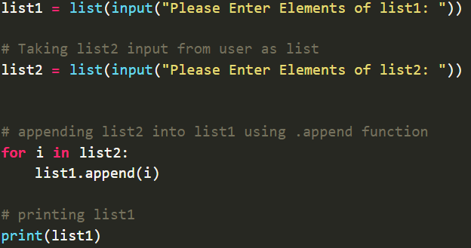
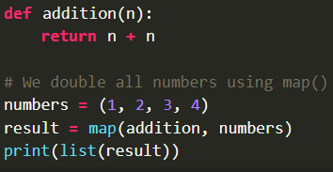

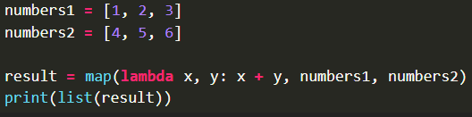
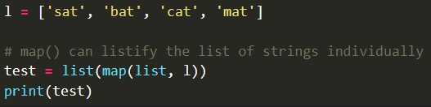
Input (1)
형식 모음
글자
Input input(prompt) → It takes user input and converts “string” → If input function is called, program stop and wait user input → Type of returned object is <class ‘str’> → In Python 2.x, automatically convert input type - Vulnerability: variable/function name as parameter → in Python 3.x, explicitly convert input type raw_input(prompt) → old version(python 2.x), it similar input() in Python 3.x → Use method is same as input function Multiple Input → Using split(), map(), get multiple input → split() is used to separate string - syntax: input().split(separator, maxsplit) → separator: delimiter(default: white space) → maxsplit: number(default: -1(no limit) - If empty in (), white space is separator → map() is used to convert string to int or float - return map object(iterator) - map(fun, iter) → fun: function to which map passes each elements of iterable → iter: iterable which is to be mapped → Ex) x, y = input(), input() → Ex) x, y = input(“enter 2 values: “).split() # input value: 2, 5 print(x) # print 2 print(y) # print 5 m, n = map(int, input().split())
메인 내용
코드
(x₁, y₁)
(x₂, y₂)
(x_{m}, y_{m})
Result
Inside first_space
Ctrl+ = ➔ 아래첨자 Ctrl + shift + = ➔ 윗첨자 Ctrl + space ➔ 복구 Shift + f3 ➔ 대소문자 변경
예시 표시
Partition
그림 설명
예시
Code
예시
code
Mismatch
글자설명
Pattern
(-2,-2) | (-2,-1) | (-2,0) | (-2,1) | (-2,2)
(-1,-2) | (-1,-1) | (-1,0) | (-1,1) | (-1,2)
(0,-2) | (0,-1) | (x,y) | (0,1) | (0,2)
(1,-2) | (1,-1) | (1,0) | (1,1) | (1,2)
(2,-2) | (2,-1) | (2,0) | (2,1) | (2,2)
Notes:
https://www.geeksforgeeks.org/taking-input-in-python/?ref=outind

Slide 7
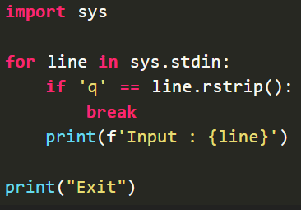
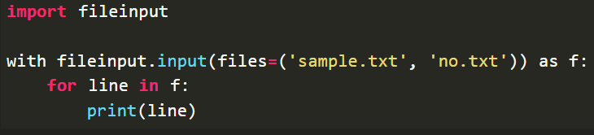
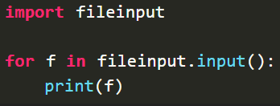
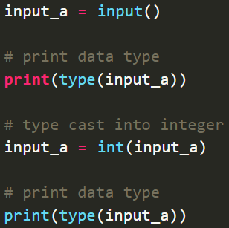
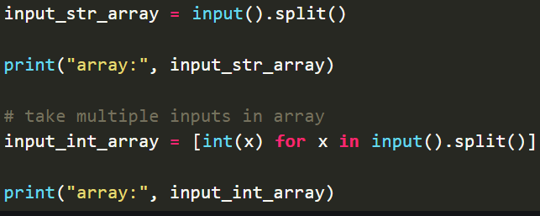
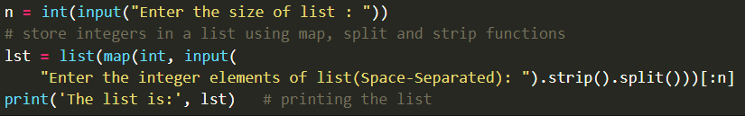
Input (2)
형식 모음
글자
Input from stdin → sys.stdin - import sys module - get input from command line and internally call input(), automatically add ‘\n’ → input() → fileinput.input() - import fileinput module - Reading multiple files → Using fileinput.input() with providing file names → Using fileinput.input() with command line Integer Input
메인 내용
코드
(x₁, y₁)
(x₂, y₂)
(x_{m}, y_{m})
Result
Inside first_space
Ctrl+ = ➔ 아래첨자 Ctrl + shift + = ➔ 윗첨자 Ctrl + space ➔ 복구 Shift + f3 ➔ 대소문자 변경
예시 표시
Partition
그림 설명
예시
Code
예시
code
Mismatch
글자설명
Pattern
(-2,-2) | (-2,-1) | (-2,0) | (-2,1) | (-2,2)
(-1,-2) | (-1,-1) | (-1,0) | (-1,1) | (-1,2)
(0,-2) | (0,-1) | (x,y) | (0,1) | (0,2)
(1,-2) | (1,-1) | (1,0) | (1,1) | (1,2)
(2,-2) | (2,-1) | (2,0) | (2,1) | (2,2)
Notes:
https://www.geeksforgeeks.org/taking-input-in-python/?ref=outind

Slide 8
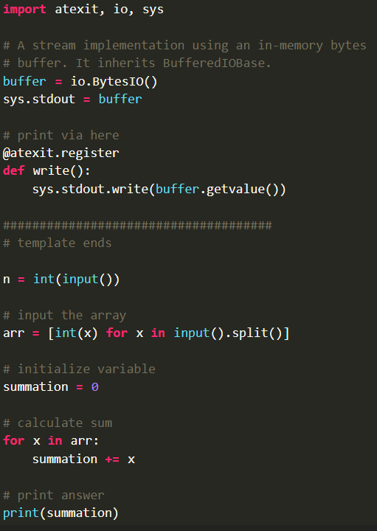
Input (3)
형식 모음
글자
Datatype of Input → a = “hello” ➔ <class ‘str’> b = 10 ➔ <class ‘int’> c = 11.2 ➔ <class ‘float’> d = (“val1”, “val2”, “val3”) ➔ <class ‘tuple’> e = {“val1”:1, “val2”:2, “val3”:3} ➔ <class ‘dic’> f = [“val1”, “val2”, “val3”] ➔ <class ‘list’> Single Character Input → Using loop(if-else) statement and len() → Using string indexing - Ex) a = input()[0] # input: asdf print(a) ➔ a - Ex) a = input()[2] # input: asdf print(a) ➔ d - Ex) a = input()[-1] # input: asdf print(a) ➔ f input() vs sys.stdin.readline() → input() can’t read escape character, sys.stdin.readline() can read escape character → input() can’t read input data by limiting string length, sys.stdin.readline() can read input data by limiting string length Fast I/O → Ex) def get_ints(): return map(int, sys.stdin.readline().strip().split()) a, b, c, d = get_ints() → Ex) def get_string(): return sys.stdin.readline().strip() string = get_string() → Adding buffered pipe io - Adding buffered IO code before submission code to make output faster - io.BytesIO objects implements common interface(file-like object) - BytesIO objects have internal pointer, every call of read(n) pointer advances - atexit module provides simple interface to register function to be called when program closes down normally - Ex) input = io.BytesIO(os.read(0, os.fstat(0).st_size)).readline s = input().decode() sys.stdout.write(str(n)+”\n”)#integer, write(s)#string, write(“ “.join(map(str,arr))+”\n”) #array(list)
※ type(variable_name) type() gets return value’s type of variable Ex) val = input(“enter:”), print(type(val)) ➔ <class ‘str’> Ex) val = int(input(“enter:”)), print(type(val)) ➔ <class ‘int’>
(x₁, y₁)
메인 내용
코드
(x₂, y₂)
(x_{m}, y_{m})
Result
Inside first_space
Ctrl+ = ➔ 아래첨자 Ctrl + shift + = ➔ 윗첨자 Ctrl + space ➔ 복구 Shift + f3 ➔ 대소문자 변경
예시 표시
Partition
그림 설명
예시
Code
예시
code
Mismatch
글자설명
Pattern
(-2,-2) | (-2,-1) | (-2,0) | (-2,1) | (-2,2)
(-1,-2) | (-1,-1) | (-1,0) | (-1,1) | (-1,2)
(0,-2) | (0,-1) | (x,y) | (0,1) | (0,2)
(1,-2) | (1,-1) | (1,0) | (1,1) | (1,2)
(2,-2) | (2,-1) | (2,0) | (2,1) | (2,2)
Notes:
https://www.geeksforgeeks.org/taking-input-in-python/?ref=outind

Slide 9
Input (4)
형식 모음
글자
Input as list or tuple → Ex) lst = [], n = int(input()) #Using Loop for i in range(0, n): ele = int(input()) lst.append(ele) → Ex) for i in range(0, n): #Using list of lists ele = [input(), int(input())] lst.append(ele) → Ex) try: #Using Exception Handling lst = [] while True: lst.append(int(input())) except: print(lst) → Ex) a = list(map(int, input().strip().split()))[:n] #Using map() → Ex) x, y = [int(t) for t in input().split()] #input: 2, 3 print(“{}, {}”.format(x, y)) ➔ 2, 3 → Ex) x = [int(x) for x in sys.stdin.readline().split()] #input: 2 3 4 print(x) ➔ [2, 3, 4] → Ex) n = list(map(int, input().split())) #input: 4, 5, 6, 1, 56, 21 print(n) ➔ [4, 5, 6, 1, 56, 21] → Ex) str, *lst = input().split() #input: hello 2 0 2 0 lst = list(map(int, lst)) print(str, lst) ➔ hello [2, 0, 2, 0]
메인 내용
코드
(x₁, y₁)
(x₂, y₂)
(x_{m}, y_{m})
Result
Inside first_space
Ctrl+ = ➔ 아래첨자 Ctrl + shift + = ➔ 윗첨자 Ctrl + space ➔ 복구 Shift + f3 ➔ 대소문자 변경
예시 표시
Partition
그림 설명
예시
Code
예시
code
Mismatch
글자설명
Pattern
(-2,-2) | (-2,-1) | (-2,0) | (-2,1) | (-2,2)
(-1,-2) | (-1,-1) | (-1,0) | (-1,1) | (-1,2)
(0,-2) | (0,-1) | (x,y) | (0,1) | (0,2)
(1,-2) | (1,-1) | (1,0) | (1,1) | (1,2)
(2,-2) | (2,-1) | (2,0) | (2,1) | (2,2)
Notes:
https://www.geeksforgeeks.org/taking-input-in-python/?ref=outind

Slide 10
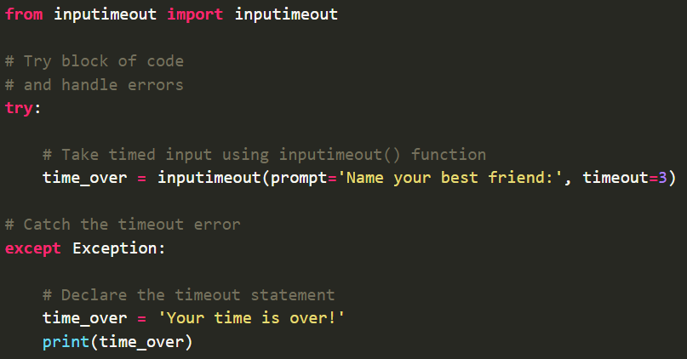

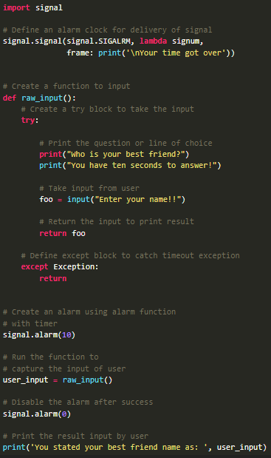
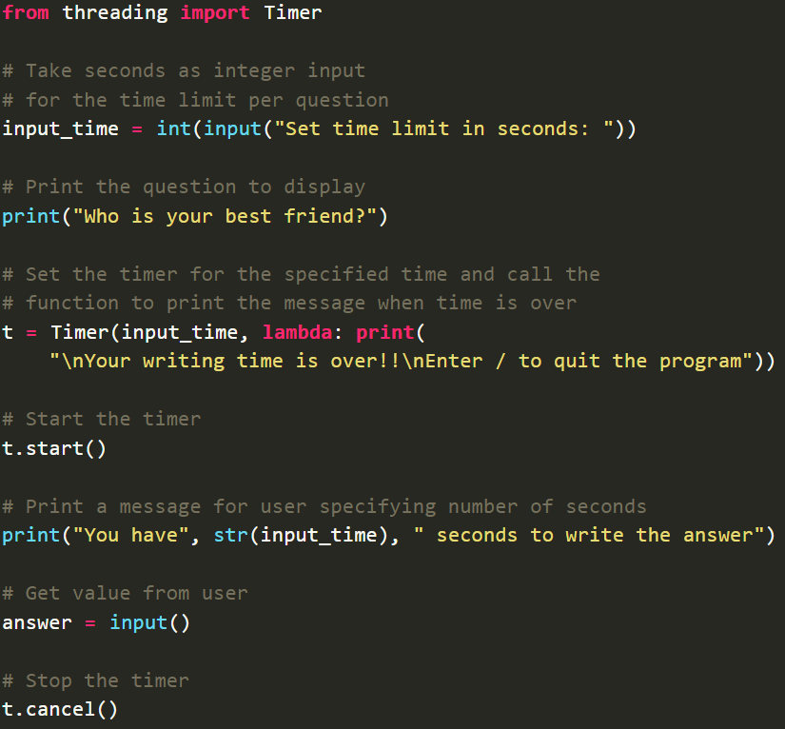
Input Time Limit
형식 모음
글자
Input Time Limit Method → Using inputimeout module - Module installation: pip install inputimeout - It can be used on multiple platforms - Using try-except statement, handle timeout error → Using select module - Module installation: pip install select - It can be used for connection to platform-specific input-output monitoring functions - Using if-else statement, handle timeout statement → Using signal module - Module installation: pip install signal - Receiving info from OS, pass info to program in form of signals - Define signal handler, create alarm function → Using threading module - Module installation: pip install threading - Using Timer in threading
메인 내용
코드
(x₁, y₁)
(x₂, y₂)
(x_{m}, y_{m})
Result
Inside first_space
Ctrl+ = ➔ 아래첨자 Ctrl + shift + = ➔ 윗첨자 Ctrl + space ➔ 복구 Shift + f3 ➔ 대소문자 변경
예시 표시
Partition
그림 설명
예시
Code
예시
code
Mismatch
글자설명
Pattern
(-2,-2) | (-2,-1) | (-2,0) | (-2,1) | (-2,2)
(-1,-2) | (-1,-1) | (-1,0) | (-1,1) | (-1,2)
(0,-2) | (0,-1) | (x,y) | (0,1) | (0,2)
(1,-2) | (1,-1) | (1,0) | (1,1) | (1,2)
(2,-2) | (2,-1) | (2,0) | (2,1) | (2,2)
Notes:
https://www.geeksforgeeks.org/taking-input-in-python/?ref=outind

Slide 11
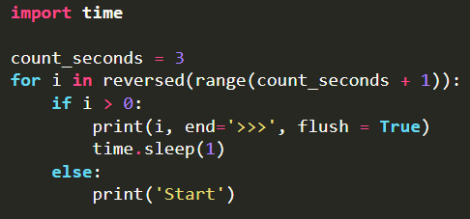
Output (1)
형식 모음
글자
Output various output formats( format(), manipulation of sep and end parameters, f-strings, versatile % operator) print() function syntax → print(value(s), sep=‘’, end=‘\n’, file=file, flush=flush) → sep default: ‘’ → end default: ‘\n’ → file default: sys.stdout ➔ file: object with write method → flush default: false ➔ flush: specifying if output is flushed(true) or buffered(false) using boolean - If flush is true, each statement is printed separately - If flush is false, each statement is printed simultaneously → Using + operator, concatenating string is possible Ex) print(‘val1 is ‘ + ‘defined’) ➔ val1 is defined Using format() → Ex) amout = 150.75, print(“amout: ${:.2f}”.format(amount)) ➔ amout: $150.75 → Ex) print(‘{0} and {1}’.format(‘A’, ‘B’)) ➔ A and B → Ex) print(‘{1} and {0}’.format(‘A’, ‘B’)) ➔ B and A → Ex) print(“Val1: {0: 2d}, Val2: {other:7.2f}”.format(52, other=23.54)) ➔ Val1: 52, Val2: 23.54 → Ex) tab = {‘val1’ : 12, ‘val2’:34, ‘val3’:56} print(‘val1: {0[val1]:d}, val2: {0[val2]:d}, val3: {0[val3]:d}’.format(tab)) ➔ val1: 12, val2: 34, val3: 56 → Ex) data = dict(val1= “hello”, val2=“world”) print(“{val1} {val2}”.format(**data)) ➔ hello world Using sep and end parameter → sep(separator) is used for separating words → end is used for denoting last word → Ex) print(“Val1”, end=‘@’) print(“Val2”) ➔ Val1@Val2 print(‘G’, ‘F’, ‘G’, sep=‘’) ➔ GFG print(’09’, ‘12’, ‘2016’, sep=‘-’) ➔ 09-12-2016 print(‘’val3’, ‘val4’, sep=‘@’) ➔ val3@val4 Using f-string → Ex) name = ‘val1’, age = 23, print(f”hello, my name is {name} and I’m {age} years old.”) ➔ hello, my name is val1 and I’m 23 years old.
메인 내용
코드
(x₁, y₁)
(x₂, y₂)
(x_{m}, y_{m})
Result
Inside first_space
Ctrl+ = ➔ 아래첨자 Ctrl + shift + = ➔ 윗첨자 Ctrl + space ➔ 복구 Shift + f3 ➔ 대소문자 변경
예시 표시
Partition
그림 설명
예시
Code
예시
code
Mismatch
글자설명
Pattern
(-2,-2) | (-2,-1) | (-2,0) | (-2,1) | (-2,2)
(-1,-2) | (-1,-1) | (-1,0) | (-1,1) | (-1,2)
(0,-2) | (0,-1) | (x,y) | (0,1) | (0,2)
(1,-2) | (1,-1) | (1,0) | (1,1) | (1,2)
(2,-2) | (2,-1) | (2,0) | (2,1) | (2,2)
Notes:
https://www.geeksforgeeks.org/taking-input-in-python/?ref=outind
https://www.geeksforgeeks.org/python-string/

Slide 12
Output (2)
형식 모음
글자
Using String Modulo Operator(%) → string formatting을 위해 string class에 의해 overloading 됨 → Format string + String modulo operator + Tuple with value 형태 → %[flags][width][.precision]type → Ex) print(“val1: %2d, val2: %5.2f” % (1, 05.333)) print(“val3: %3d, val4: %2d” % (240, 120)) print(“%7.3o” % (25)) #8진수 변환 print(“%10.3E” % (356.08977)) #지수형태 변환 ➔ val1: 1, val2: 5.33, val3: 240, val4: 120, 031, 3.561E+02 Using String Alignment Method → For string alignment, use str.ljust(s, width[,fillchar]), str.rjust(s, width[,fillchar]), str.centre(s, width[,fillchar]) - fillchar default: white space → Using format() and :, alignment of string is possible - < : string should be aligned to left - > : string should be aligned to right - ^ : string should be aligned to center → Ex) str1 = “|{:<10}|{:^10}|{:>10}|”.format(‘Hello’, ‘for’, ‘World’) ➔ |Hello | for | World| → Ex) cstr = “Hello World” print(cstr.centre(21, ‘#’)) ➔ #####Hello World##### print(cstr.ljust(21, ‘-’)) ➔ Hello World---------- print(cstr.rjust(21, ‘-’)) ➔ ----------Hello World Format Conversion Rule → d: decimal integer, b: binary integer, o: octal format, e(E): exponential notation, f: float-point decimal, g(G): general format, c: single character → r: string format using repr(), s: string format using str() Example of Output → lst = [‘I’, ‘like’, ‘cheese’] for i in lst: print(i, end=‘ ’) ➔ I like cheese → words_str = input() #input: geeks for geeks words = {word: len(word) for word in words_str.split()} print(words) ➔ {‘geeks’: 5, ‘for’: 3}
메인 내용
코드
(x₁, y₁)
(x₂, y₂)
(x_{m}, y_{m})
Result
Inside first_space
Ctrl+ = ➔ 아래첨자 Ctrl + shift + = ➔ 윗첨자 Ctrl + space ➔ 복구 Shift + f3 ➔ 대소문자 변경
예시 표시
Partition
그림 설명
예시
Code
예시
code
Mismatch
글자설명
Pattern
(-2,-2) | (-2,-1) | (-2,0) | (-2,1) | (-2,2)
(-1,-2) | (-1,-1) | (-1,0) | (-1,1) | (-1,2)
(0,-2) | (0,-1) | (x,y) | (0,1) | (0,2)
(1,-2) | (1,-1) | (1,0) | (1,1) | (1,2)
(2,-2) | (2,-1) | (2,0) | (2,1) | (2,2)
Notes:
https://www.geeksforgeeks.org/taking-input-in-python/?ref=outind

Slide 13
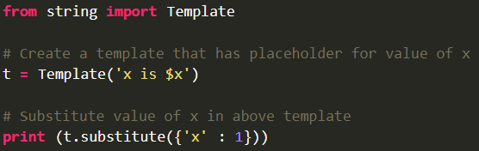
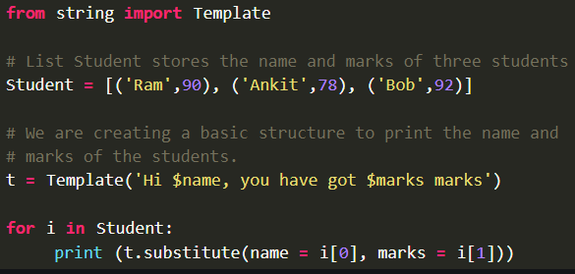
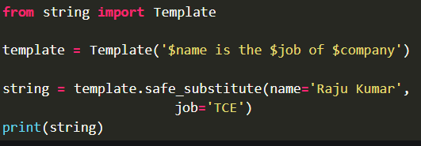
Output (3)
형식 모음
글자
String Template Class → placeholder name formed by $ and valid identifiers is used → Surrounding placeholder with braces allow more letters with no intervening spaces → && create single escaped $ → Method - template is created by passing template string to its contructor - substitute(mapping, **kwds) → Using dictionary → If key based mapping object, keyword have same key, throw TypeError → If keys are missing, return KeyError - safe_substitute(mapping, **kwds) → Similar substitute method, but doesn’t throw KeyError if key is missing → return placeholder - If placeholder isn’t supplied in dictionary or keyword, KeyError raised - template attribute used to return template string(Ex. t = Template(‘I $key’), print(‘=‘, t.template) - ${Identifier} is similar $Identifier, but partially substitute characters Using dictionary for string formatting → Using ** operator to unpack values into placeholders in string → Ex) intro = ‘{first} is {second} and {third} is {firth}.’ desc = { ‘first’ : ‘a’, ‘second’ : ‘b’, ‘third’ : ‘c’, ‘firth’ : ‘d’} print(intro.format(**desc)) ➔ a is b and c is d
메인 내용
코드
(x₁, y₁)
(x₂, y₂)
(x_{m}, y_{m})
Result
Inside first_space
Ctrl+ = ➔ 아래첨자 Ctrl + shift + = ➔ 윗첨자 Ctrl + space ➔ 복구 Shift + f3 ➔ 대소문자 변경
예시 표시
Partition
그림 설명
예시
Code
예시
code
Mismatch
글자설명
Pattern
(-2,-2) | (-2,-1) | (-2,0) | (-2,1) | (-2,2)
(-1,-2) | (-1,-1) | (-1,0) | (-1,1) | (-1,2)
(0,-2) | (0,-1) | (x,y) | (0,1) | (0,2)
(1,-2) | (1,-1) | (1,0) | (1,1) | (1,2)
(2,-2) | (2,-1) | (2,0) | (2,1) | (2,2)
Notes:
https://www.geeksforgeeks.org/taking-input-in-python/?ref=outind
https://www.geeksforgeeks.org/python-string-format-method/

Slide 14
Operator (1)
형식 모음
글자
Python Operator Arithmetic Operator → +, -, *, %, / (In python 2.x, / return integer, in python 3.x / return float) → // (division floor-return integer) → ** (power) → Precedence - Parentheses, Exponentiation, Multiplication/Division, Addition/Substraction Comparison Operator → <, <=, >, >=, ==, != → Precedence - Arithmetic operator > Comparison operator - Comparison operator has same precedence Logical Operator → and, or, not → Precedence - not > and > or Bitwise Operator → &, |, <<, >>, ~, ^ → Precedence - not > shift > and > xor > or Assignment Operator → =, +=, -=, *=, %= Identity Operator → is, is not → To check if 2 values are located on same part of memory Membership Operator → in, not in → To test whether value or variable is in a sequence Ternary Operator → [on_true] if [expression] else [on_false]
메인 내용
코드
(x₁, y₁)
(x₂, y₂)
(x_{m}, y_{m})
Result
Inside first_space
Ctrl+ = ➔ 아래첨자 Ctrl + shift + = ➔ 윗첨자 Ctrl + space ➔ 복구 Shift + f3 ➔ 대소문자 변경
예시 표시
Partition
그림 설명
예시
Code
예시
code
Mismatch
글자설명
Pattern
(-2,-2) | (-2,-1) | (-2,0) | (-2,1) | (-2,2)
(-1,-2) | (-1,-1) | (-1,0) | (-1,1) | (-1,2)
(0,-2) | (0,-1) | (x,y) | (0,1) | (0,2)
(1,-2) | (1,-1) | (1,0) | (1,1) | (1,2)
(2,-2) | (2,-1) | (2,0) | (2,1) | (2,2)
Notes:
https://www.geeksforgeeks.org/taking-input-in-python/?ref=outind

Slide 15
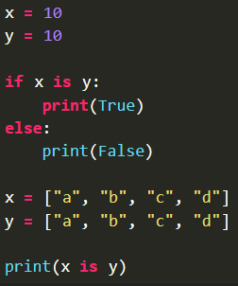

Operator (2)
형식 모음
글자
is Operator → To test whether 2 variables belong to same object in Operator → Check if value is present in list, tuple, range, string, etc
메인 내용
코드
(x₁, y₁)
(x₂, y₂)
(x_{m}, y_{m})
Result
Inside first_space
Ctrl+ = ➔ 아래첨자 Ctrl + shift + = ➔ 윗첨자 Ctrl + space ➔ 복구 Shift + f3 ➔ 대소문자 변경
예시 표시
Partition
그림 설명
예시
Code
예시
code
Mismatch
글자설명
Pattern
(-2,-2) | (-2,-1) | (-2,0) | (-2,1) | (-2,2)
(-1,-2) | (-1,-1) | (-1,0) | (-1,1) | (-1,2)
(0,-2) | (0,-1) | (x,y) | (0,1) | (0,2)
(1,-2) | (1,-1) | (1,0) | (1,1) | (1,2)
(2,-2) | (2,-1) | (2,0) | (2,1) | (2,2)
Notes:
https://www.geeksforgeeks.org/boolean-data-type-in-python/

Slide 16
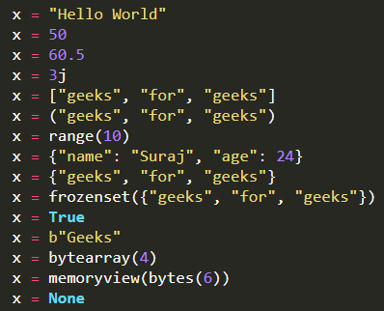
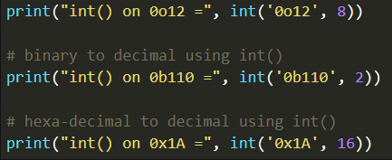

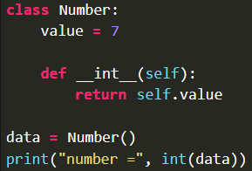

Variable (1)
형식 모음
글자
Variable variable is container variable name must start with letter / underscore (can’t start with number) variable name is case-sensitive(name, Name, NAME are different) Using =, assign single value to variable like a = b = c = 10 Using ,, assign different value to multiple variables like a, b, c = 1, 20.2, “hello” If use same name variable, variable refers to new value and type like a = 10, a = “hello” global keyword is declared inside function(not outside function) Single variable → Using print() → Using concatenation Ex) name = “asd”, print(“Name:”, name) ➔ Name: asd → Using f-string Ex) name = “dsa”, print(f”Name: {name}”) ➔ Name: dsa Multiple variable → Using unpacking Ex) name, age, city = “John”, 30, “New York”, print(name) ➔ John → Using multiple assignment Ex) a, b, c = 1, 2, 3, print(a, b, c) ➔ 1 2 3 → Using f-string - f-string(formatted string literal) - If f-string uses dictionary variable and accesses value of dictionary, use ‘’ like {person[‘name’]} (person: variable name, name: key) Data type → Data type is class, variable is instance of class → Built-in data type - Numeric(Integer, Float, Complex number) → integer - int class, no limit to how long - Syntax: int(x, base) → x: optional, string(default: 0) → base: optional, base of number(default: 10) - Exception → TypeError: when object don’t have __int__() or __index__() → ValueError: when object can’t be converted to integer
메인 내용
코드
(x₁, y₁)
(x₂, y₂)
(x_{m}, y_{m})
Result
Inside first_space
Ctrl+ = ➔ 아래첨자 Ctrl + shift + = ➔ 윗첨자 Ctrl + space ➔ 복구 Shift + f3 ➔ 대소문자 변경
예시 표시
Partition
그림 설명
예시
Code
예시
code
Mismatch
글자설명
Pattern
(-2,-2) | (-2,-1) | (-2,0) | (-2,1) | (-2,2)
(-1,-2) | (-1,-1) | (-1,0) | (-1,1) | (-1,2)
(0,-2) | (0,-1) | (x,y) | (0,1) | (0,2)
(1,-2) | (1,-1) | (1,0) | (1,1) | (1,2)
(2,-2) | (2,-1) | (2,0) | (2,1) | (2,2)
Notes:
https://www.geeksforgeeks.org/python-variables/
https://www.geeksforgeeks.org/python-data-types/?ref=lbp
https://www.geeksforgeeks.org/python-int-function/

Slide 17
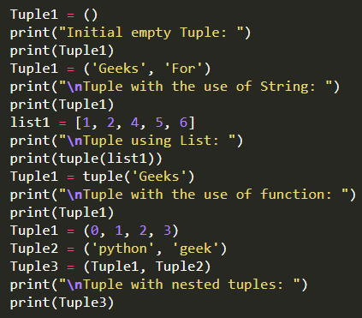
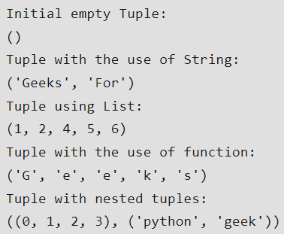
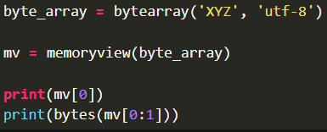

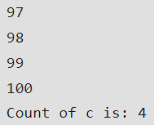
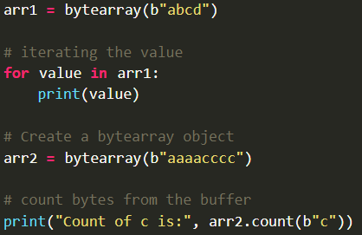
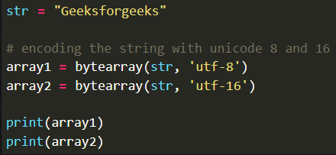

Variable (2)
형식 모음
글자
→ float: float class, any number/number in form of string, inf/infinity/NaN → complex number: complex class - Syntax: complex([real[, imaginary]]) → real: optional, numeric type, default: 0 → imaginary: optional, numeric type, default: 0 → Exception(ValueError): if first element is string, second element shouldn’t be passed(string must not contain whitespace around +, - ) - Sequence type(String, List, Tuple) → String: str class → List: use square brackets( [] ), → Tuple - difference with list is immutable(can’t modify), use parentheses ( () ) - For access element, index must be integer - Boolean(True, False) - Set → unordered, mutable, iterable, no duplicate elements, use curly braces {} → For access element, use loop - Dictionary: use curly braces( {} ) - Binary type(memoryview, bytearray, bytes) → memoryview(obj) - Safe way to expose buffer protocol(avoid copy and juggle pointer to data) - Buffer protocol: way to access internal data(memory array/buffer) of object - Direct read and write access to object data without copy(useful when slicing) → bytearray(source, encoding, errors) - provide mutable sequence of integer(0 <= x <= 255) - source: optional, initialize array of bytes - encoding: optional, encoding of string - errors: optional, take actions when encoding fails → bytes(src, enc, err) - Convert object to immutable byte object - src: source object be converted - enc: encoding if object is string - err: way to handle error if string conversion fails
메인 내용
코드
(x₁, y₁)
(x₂, y₂)
(x_{m}, y_{m})
Result
Inside first_space
Ctrl+ = ➔ 아래첨자 Ctrl + shift + = ➔ 윗첨자 Ctrl + space ➔ 복구 Shift + f3 ➔ 대소문자 변경
예시 표시
Partition
그림 설명
예시
Code
예시
code
Mismatch
글자설명
Pattern
(-2,-2) | (-2,-1) | (-2,0) | (-2,1) | (-2,2)
(-1,-2) | (-1,-1) | (-1,0) | (-1,1) | (-1,2)
(0,-2) | (0,-1) | (x,y) | (0,1) | (0,2)
(1,-2) | (1,-1) | (1,0) | (1,1) | (1,2)
(2,-2) | (2,-1) | (2,0) | (2,1) | (2,2)
Notes:
https://www.geeksforgeeks.org/python-variables/
https://www.geeksforgeeks.org/python-data-types/?ref=lbp
https://www.geeksforgeeks.org/dunder-magic-methods-python/
https://www.geeksforgeeks.org/float-in-python/
https://www.geeksforgeeks.org/python-complex-function/
https://www.geeksforgeeks.org/memoryview-in-python/
https://www.geeksforgeeks.org/python-bytearray-function/

Slide 18
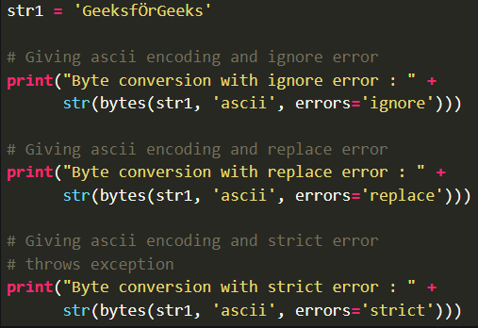

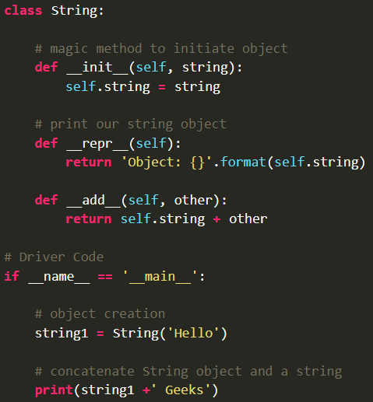
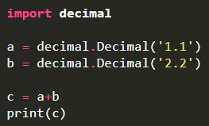
Variable (3)
형식 모음
글자
- Return → Integer: array of size initialized to null → Iterable: array of iterable size with elements(0-256) → string: encoded string → No arguments: array of size 0 - String Error Handler → strict: when encode failure, raise default UnicodeDecodeError → ignore: ignore unencodable character and encode remaining string → replace: replace unencodable character with ‘?’ ※ Magic Method starting and ending with __ used for operator overloading called Dunder method(Double Underscores) Using dir(data_type), confirm the magic methods like print(dir(int)) ※ Decimal Error To avoid decimal error caused by calculation of float point variables Using decimal module(import decimal) Useful when defining accuracy of float type, financial applications, etc
메인 내용
코드
(x₁, y₁)
(x₂, y₂)
(x_{m}, y_{m})
Result
Inside first_space
Ctrl+ = ➔ 아래첨자 Ctrl + shift + = ➔ 윗첨자 Ctrl + space ➔ 복구 Shift + f3 ➔ 대소문자 변경
예시 표시
Partition
그림 설명
예시
Code
예시
code
Mismatch
글자설명
Pattern
(-2,-2) | (-2,-1) | (-2,0) | (-2,1) | (-2,2)
(-1,-2) | (-1,-1) | (-1,0) | (-1,1) | (-1,2)
(0,-2) | (0,-1) | (x,y) | (0,1) | (0,2)
(1,-2) | (1,-1) | (1,0) | (1,1) | (1,2)
(2,-2) | (2,-1) | (2,0) | (2,1) | (2,2)
Notes:
https://www.geeksforgeeks.org/python-variables/
https://www.geeksforgeeks.org/python-numbers/#decimal-numbers-in-python
https://www.geeksforgeeks.org/python-data-types/?ref=lbp
https://www.geeksforgeeks.org/dunder-magic-methods-python/
https://www.geeksforgeeks.org/float-in-python/
https://www.geeksforgeeks.org/python-complex-function/
https://www.geeksforgeeks.org/memoryview-in-python/
https://www.geeksforgeeks.org/python-bytearray-function/
https://www.geeksforgeeks.org/python-bytes-method/

Slide 19
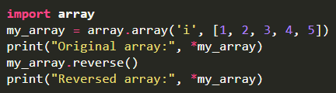
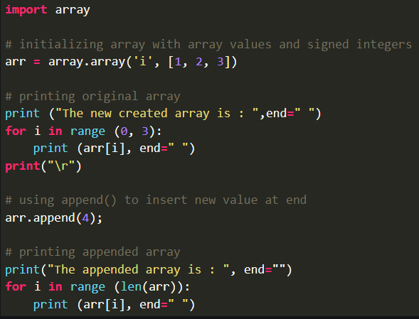
Array (1)
형식 모음
글자
Array In contrast with list, all elements of array must be same type and size Stored at contiguous memory location For using array, import array Syntax: array.array(type, value_list) → Ex) a = array.array(‘i’, [1, 2, 3]) → Ex) b = array.array(‘d’, [2.5, 3.5, 4.5]) Type Explanation → ‘u’ = Unicode character (min 2 byte) → ‘b’ = signed char (min 1 byte) → ‘h’ = signed short (min 2 byte) → ‘i’ = signed int (min 2 byte) → ‘I’ = unsigned int (min 2 byte) → ‘l’ = signed long (min 4 byte) → ‘q’ = signed long long (min 8 byte) → ‘f’ = float (min 4 byte) → ‘d’ = double (min 8 byte) → except u, f and d, capital character is unsigned → f, d are perceived float in python, and remainders(except u) are perceived int in python For adding elements, use insert(pos, value) or append(value) For access element, use indexing like arr[3] For removing element, use remove(value) or pop(pos) For searching element, use index(value) For extending element with iterable, use extend(iterable) For counting specific element, use count() For reverse array, use reverse() For check array type, use arr.typecode like print(arr.typecode) For check element size, use arr.itemsize like print(arr.itemsize) For check address and number of elements, use arr.buffer_info() like print(arr.buffer_info()) [buffer_info() returns tuple (address, number of elements)] For append array using list, use arr.fromlist(list) For transform array to list, use arr.tolist() like list1 = arr.tolist()
메인 내용
코드
(x₁, y₁)
(x₂, y₂)
(x_{m}, y_{m})
Result
Inside first_space
Ctrl+ = ➔ 아래첨자 Ctrl + shift + = ➔ 윗첨자 Ctrl + space ➔ 복구 Shift + f3 ➔ 대소문자 변경
예시 표시
Partition
그림 설명
예시
Code
예시
code
Mismatch
글자설명
Pattern
(-2,-2) | (-2,-1) | (-2,0) | (-2,1) | (-2,2)
(-1,-2) | (-1,-1) | (-1,0) | (-1,1) | (-1,2)
(0,-2) | (0,-1) | (x,y) | (0,1) | (0,2)
(1,-2) | (1,-1) | (1,0) | (1,1) | (1,2)
(2,-2) | (2,-1) | (2,0) | (2,1) | (2,2)
Notes:
https://www.geeksforgeeks.org/python-arrays/
https://www.geeksforgeeks.org/array-python-set-1-introduction-functions/
https://www.geeksforgeeks.org/array-in-python-set-2-important-functions/

Slide 20
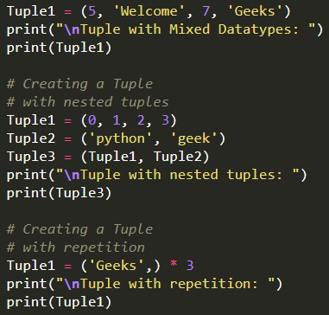
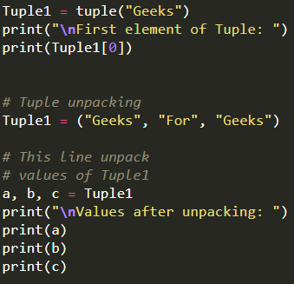
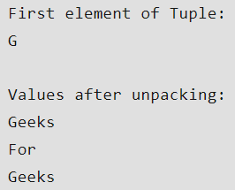
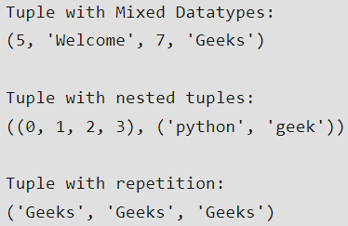
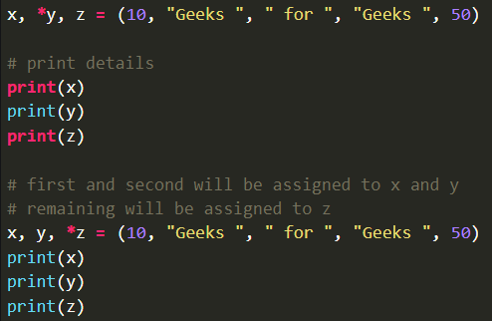
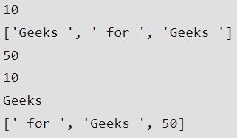


Tuple (1)
형식 모음
글자
Tuple Immutable Indexed by integer Values are separated by comma Use paretheses () For access element, use index or unpacking For concatenation, use + operator like tup1 + tup2 For deleting, use del keyword like del tup1 Difference of tuple and list → Generally, use tuple for heterogeneous data type, use list for homogeneous data type → Iterating through tuple is faster than in list → tuple is immutable, list is mutable ※ Unpacking - number of variables on left-hand side should be equal to number of values in given tuple *args → all remaining values will be assigned to (*args) → use input parameter of function like def mul(x, y): ... , print(mul(*z))
메인 내용
코드
(x₁, y₁)
(x₂, y₂)
(x_{m}, y_{m})
Result
Inside first_space
Ctrl+ = ➔ 아래첨자 Ctrl + shift + = ➔ 윗첨자 Ctrl + space ➔ 복구 Shift + f3 ➔ 대소문자 변경
예시 표시
Partition
그림 설명
예시
Code
예시
code
Mismatch
글자설명
Pattern
(-2,-2) | (-2,-1) | (-2,0) | (-2,1) | (-2,2)
(-1,-2) | (-1,-1) | (-1,0) | (-1,1) | (-1,2)
(0,-2) | (0,-1) | (x,y) | (0,1) | (0,2)
(1,-2) | (1,-1) | (1,0) | (1,1) | (1,2)
(2,-2) | (2,-1) | (2,0) | (2,1) | (2,2)
Notes:
https://www.geeksforgeeks.org/unpacking-a-tuple-in-python/
https://www.geeksforgeeks.org/python-tuples/

Slide 21












Dictionary (1)
형식 모음
글자
Dictionary → key : value (pairs) → Syntax: dir_val = {key1:val1, key2:val2, ...} → It’s different from list, tuple, array cuz each key has associated value(as of Python 3.7, dic_val are ordered and can’t contain duplicated keys) → value can be of any data type, can be duplicated → Using dict(), It can be created dictionary → Use indexing to add elements or Use update() Ex) Dict = {}, Dict[0] = ‘Hello’ → To access value of dictionary, refer to key name or get(key name) → To delete element, use del(val_name[key_name]) → Method - dict.clear(): remove all elements - dict.copy(): return copy of dictionary - dict.get(key, default=“None”): return value of key - dict.items(): return list containing tuple for each key value pair - dict.keys(): return list containing dictionary’s key - dict.update(dict2): update dictionary with key-value pair - dict.values(): return list of all values of dictionary - pop(): remove element with specified key - popItem(): remove last inserted key-value pair - dict.setdefault(key, default=“None”): set key to default value if key isn’t specified - dict.has_key(key): return true if dictionary contains specified key - dict.fromkeys(seq, val): create dictionary from given sequence
메인 내용
코드
(x₁, y₁)
(x₂, y₂)
(x_{m}, y_{m})
Result
Inside first_space
Ctrl+ = ➔ 아래첨자 Ctrl + shift + = ➔ 윗첨자 Ctrl + space ➔ 복구 Shift + f3 ➔ 대소문자 변경
예시 표시
Partition
그림 설명
예시
Code
예시
code
Mismatch
글자설명
Pattern
(-2,-2) | (-2,-1) | (-2,0) | (-2,1) | (-2,2)
(-1,-2) | (-1,-1) | (-1,0) | (-1,1) | (-1,2)
(0,-2) | (0,-1) | (x,y) | (0,1) | (0,2)
(1,-2) | (1,-1) | (1,0) | (1,1) | (1,2)
(2,-2) | (2,-1) | (2,0) | (2,1) | (2,2)
Notes:
https://www.geeksforgeeks.org/python-dictionary/

Slide 22



Dictionary (2)
형식 모음
글자
- dict.fromkeys(seq, val): create dictionary from given sequence → Shallow copy occurs(if append value in list, dictionary’s values are appended → must use {key: list(list_val) for key in sequence} for preventing aliasing
메인 내용
코드
(x₁, y₁)
(x₂, y₂)
(x_{m}, y_{m})
Result
Inside first_space
Ctrl+ = ➔ 아래첨자 Ctrl + shift + = ➔ 윗첨자 Ctrl + space ➔ 복구 Shift + f3 ➔ 대소문자 변경
예시 표시
Partition
그림 설명
예시
Code
예시
code
Mismatch
글자설명
Pattern
(-2,-2) | (-2,-1) | (-2,0) | (-2,1) | (-2,2)
(-1,-2) | (-1,-1) | (-1,0) | (-1,1) | (-1,2)
(0,-2) | (0,-1) | (x,y) | (0,1) | (0,2)
(1,-2) | (1,-1) | (1,0) | (1,1) | (1,2)
(2,-2) | (2,-1) | (2,0) | (2,1) | (2,2)
Notes:
https://www.geeksforgeeks.org/python-dictionary-fromkeys-method/

Slide 23




Dictionary Comprehension (1)
형식 모음
글자
Dictionary Comprehension Syntax: {key : value for (key, value) in iterable} Method to make dictionary → Converting 2 lists to dictionary: dic1 = {k:v for (k, v) in zip(keys, values)} → Using dict.fromkeys(), like dic1 = dict.fromkeys(range(5), True) → Using dictionary comprehension: - Ex) dic1 = {x: x**2 for x in [1,2,3,4,5]} - Ex) dic1 = {x.upper(): x*3 for x in ‘coding ‘}
메인 내용
코드
(x₁, y₁)
(x₂, y₂)
(x_{m}, y_{m})
Result
Inside first_space
Ctrl+ = ➔ 아래첨자 Ctrl + shift + = ➔ 윗첨자 Ctrl + space ➔ 복구 Shift + f3 ➔ 대소문자 변경
예시 표시
Partition
그림 설명
예시
Code
예시
code
Mismatch
글자설명
Pattern
(-2,-2) | (-2,-1) | (-2,0) | (-2,1) | (-2,2)
(-1,-2) | (-1,-1) | (-1,0) | (-1,1) | (-1,2)
(0,-2) | (0,-1) | (x,y) | (0,1) | (0,2)
(1,-2) | (1,-1) | (1,0) | (1,1) | (1,2)
(2,-2) | (2,-1) | (2,0) | (2,1) | (2,2)
Notes:
https://www.geeksforgeeks.org/python-dictionary-comprehension/

Slide 24










Set (1)
형식 모음
글자
Set unordered(can’t access element by using index), iterable, mutable, no duplicate elements Use curly braces {} Based on hash table heterogeneous value is possible like sets1 = {“hello”, “for”, 10, 5.2, True} Frozen set → Immutable object → Done with frozenset() method Set is implemented using dictionary with dummy variables For adding element, use set.add() (on average case: O(1), worst case: O(n) ) → Only instances of immutable type can be added For merging sets, use set.union() or | operator ( O(len(set1) + len(set2)) ) For getting intersection elements, use set.intersection() or & operator ( O(min(len(set1), len(set2))) ) For finding difference of sets, use set.difference() or – operator ( set1-set2: O(len(set1)) ) For remove all elements in set, use set.clear() (object isn’t removed) Set Operation → ==, !=, <=, <, >, >=, |, &, -, ^(unique element in sets like s1 = { 1,2, 3}, s2={2,3,4} ➔ 1, 4
메인 내용
코드
(x₁, y₁)
(x₂, y₂)
(x_{m}, y_{m})
Result
Inside first_space
Ctrl+ = ➔ 아래첨자 Ctrl + shift + = ➔ 윗첨자 Ctrl + space ➔ 복구 Shift + f3 ➔ 대소문자 변경
예시 표시
Partition
그림 설명
예시
Code
예시
code
Mismatch
글자설명
Pattern
(-2,-2) | (-2,-1) | (-2,0) | (-2,1) | (-2,2)
(-1,-2) | (-1,-1) | (-1,0) | (-1,1) | (-1,2)
(0,-2) | (0,-1) | (x,y) | (0,1) | (0,2)
(1,-2) | (1,-1) | (1,0) | (1,1) | (1,2)
(2,-2) | (2,-1) | (2,0) | (2,1) | (2,2)
Notes:
https://www.geeksforgeeks.org/sets-in-python/

Slide 25


List (1)
형식 모음
글자
List Mutable and Dynamically sized array(set, tuple is immutable) Using brackets [] For access elements, use index(integer type) For adding element → Use append(): only one argument needed, O(1) → Use insert(): position, value needed, O(n) → Use extend(): adding multiple elements is possible, O(n) For reverse elements → Use reverse() Ex. lst = [1, 2, 3], lst.reverse() → Use reversed() Ex. lst = [1, 2, 3], rlst = list(reversed(lst)) For removing elements → Use remove(): remove first occurrence of element, O(n) → Use pop(): remove last element( O(1) ) or element at position( O(n) ) For swap elements → Use comma like lst1[0], lst[1] = lst[1], lst[0], O(1) → Use pop() , O(1) → Use tuple like tup1 = lst1[pos1], lst1[pos2], lst1[pos2], lst1[pos1] = tup1, O(1) → Use temp variable ,O(1) → Use enumerate(), O(n)
메인 내용
코드
(x₁, y₁)
(x₂, y₂)
(x_{m}, y_{m})
Result
Inside first_space
Ctrl+ = ➔ 아래첨자 Ctrl + shift + = ➔ 윗첨자 Ctrl + space ➔ 복구 Shift + f3 ➔ 대소문자 변경
예시 표시
Partition
그림 설명
예시
Code
예시
code
Mismatch
글자설명
Pattern
(-2,-2) | (-2,-1) | (-2,0) | (-2,1) | (-2,2)
(-1,-2) | (-1,-1) | (-1,0) | (-1,1) | (-1,2)
(0,-2) | (0,-1) | (x,y) | (0,1) | (0,2)
(1,-2) | (1,-1) | (1,0) | (1,1) | (1,2)
(2,-2) | (2,-1) | (2,0) | (2,1) | (2,2)
Notes:
https://www.geeksforgeeks.org/python-lists/
https://www.geeksforgeeks.org/python-program-to-swap-two-elements-in-a-list/

Slide 26









List (2)
형식 모음
글자
Methods → append(item): add element to end, O(1) → extend(iterable): add all element of list to other list, O(n) - Difference of append() and extend(): → append() add item as itself like lst = [‘a’, ‘b’], lst.append(‘he’), print(lst) ➔ [‘a’, ‘b’, ‘he’] → extend() add iterable as element like lst = [‘a’, ‘b’], lst.extend(‘he’), print(lst) ➔ [‘a’, ‘b’, ‘h’, ‘e’] → insert(index, item): insert item at index → remove(item): remove item from list → clear(): remove all items → index(item, start, end): return index of matched item - start, end: optional - Return lowest index of matched item - ValueError: if item isn’t exist in list → count(object): return the number of occurrences of item - TypeError: if >=2 parameter are passed → sort(key=..., reverse=...): sort items in ascending order, O(n log n) - key: optional, function that serves as key for sort comparison - reverse: optional, if True, sort in descending order → reverse(): reverse order of items → copy(): return copy of list(shallow copy) - Deep copy: Using copy.deepcopy() - Shallow copy: → Using copy.copy(), list.copy(), slicing: only reflect modified nested list → Using assignment operator(=): reflect modified original list → pop(index): remove and return item at index(if no index, remove and return last element)
메인 내용
코드
(x₁, y₁)
(x₂, y₂)
(x_{m}, y_{m})
Result
Inside first_space
Ctrl+ = ➔ 아래첨자 Ctrl + shift + = ➔ 윗첨자 Ctrl + space ➔ 복구 Shift + f3 ➔ 대소문자 변경
예시 표시
Partition
그림 설명
예시
Code
예시
code
Mismatch
글자설명
Pattern
(-2,-2) | (-2,-1) | (-2,0) | (-2,1) | (-2,2)
(-1,-2) | (-1,-1) | (-1,0) | (-1,1) | (-1,2)
(0,-2) | (0,-1) | (x,y) | (0,1) | (0,2)
(1,-2) | (1,-1) | (1,0) | (1,1) | (1,2)
(2,-2) | (2,-1) | (2,0) | (2,1) | (2,2)
Notes:
https://www.geeksforgeeks.org/python-lists/
https://www.geeksforgeeks.org/python-program-to-swap-two-elements-in-a-list/
https://www.geeksforgeeks.org/append-extend-python/
https://www.geeksforgeeks.org/list-methods-in-python-set-2-del-remove-sort-insert-pop-extend/
https://www.geeksforgeeks.org/python-list-index/
https://www.geeksforgeeks.org/python-list-count-method/
https://www.geeksforgeeks.org/sort-in-python/
https://www.geeksforgeeks.org/python-list-copy-method/
https://www.geeksforgeeks.org/python-list-pop-method/
https://www.geeksforgeeks.org/difference-between-shallow-and-deep-copy-of-a-class/

Slide 27






List Comprehension (1)
형식 모음
글자
List Comprehension Way to define and create list from other iterables like tuple, string, array, list, etc Component → Output expression → Input sequence → Variable → Optional predicate part → Ex) lst = [ x ** 2 for x in range(1, 11) if x % 2 == 1] Output expression: x ** 2 Input sequence: range(1, 11) Variable: x Predicate part: if x % 2 == 1 List slicing → Syntax: [start : stop : steps] - start default: 0, stop default: last index of list, step default: 1
메인 내용
코드
(x₁, y₁)
(x₂, y₂)
(x_{m}, y_{m})
Result
Inside first_space
Ctrl+ = ➔ 아래첨자 Ctrl + shift + = ➔ 윗첨자 Ctrl + space ➔ 복구 Shift + f3 ➔ 대소문자 변경
예시 표시
Partition
그림 설명
예시
Code
예시
code
Mismatch
글자설명
Pattern
(-2,-2) | (-2,-1) | (-2,0) | (-2,1) | (-2,2)
(-1,-2) | (-1,-1) | (-1,0) | (-1,1) | (-1,2)
(0,-2) | (0,-1) | (x,y) | (0,1) | (0,2)
(1,-2) | (1,-1) | (1,0) | (1,1) | (1,2)
(2,-2) | (2,-1) | (2,0) | (2,1) | (2,2)
Notes:
https://www.geeksforgeeks.org/python-list-comprehension-and-slicing/

Slide 28


Iterator
형식 모음
글자
Iterator Object used to iterate over iterable objects Use iter() for initialization of iterator Use next() for iteration Iterable can’t save state of iteration, iterator can save state of interation iterator is iterable, but not every iterable is iterator
메인 내용
코드
(x₁, y₁)
(x₂, y₂)
(x_{m}, y_{m})
Result
Inside first_space
Ctrl+ = ➔ 아래첨자 Ctrl + shift + = ➔ 윗첨자 Ctrl + space ➔ 복구 Shift + f3 ➔ 대소문자 변경
예시 표시
Partition
그림 설명
예시
Code
예시
code
Mismatch
글자설명
Pattern
(-2,-2) | (-2,-1) | (-2,0) | (-2,1) | (-2,2)
(-1,-2) | (-1,-1) | (-1,0) | (-1,1) | (-1,2)
(0,-2) | (0,-1) | (x,y) | (0,1) | (0,2)
(1,-2) | (1,-1) | (1,0) | (1,1) | (1,2)
(2,-2) | (2,-1) | (2,0) | (2,1) | (2,2)
Notes:
https://www.geeksforgeeks.org/iterators-in-python/
https://www.geeksforgeeks.org/python-difference-iterable-iterator/

Slide 29








String
형식 모음
글자
String data structure that represents sequence of characters(python hasn’t character type) Immutable type(Reassignment is possible) → For update and deletion of string, convert string to list and later, convert list to string → For update and deletion of string, use slicing method → If use del keyword like del str1, str1 object is deleted Using single quote or double quotes or triple quotes For access each character, use positive/negative index(Refer “String Index and Slice” page) Reverse → Using loop ( O(n, 1) ) → Using recursion ( O(n, n) ) → Using stack ( O(n, n) ) → Using slicing method ( O(n, 1) ) → Using reversed() ( O(n, n) ) → Using list comprehension ( O(n, 1) ) → Using list and list’s function ( O(n, 1) ) For using single/double quotes in string, use \quote or triple quotes outside string or different quote inside string Output of boolean operation between strings → and operator: if 1st element is false return 1st element, if 1st, 2nd element is true return 2nd element → or operator: if 1st element is true return 1st element, if 1st element is false and 2nd element is true return 2nd element → Ex) print(repr(str1 and str2)) Duplicated character → Using reduce(), filter(), count(), Counter(), set(), join()
메인 내용
코드
(x₁, y₁)
(x₂, y₂)
(x_{m}, y_{m})
Result
Inside first_space
Ctrl+ = ➔ 아래첨자 Ctrl + shift + = ➔ 윗첨자 Ctrl + space ➔ 복구 Shift + f3 ➔ 대소문자 변경
예시 표시
Partition
그림 설명
예시
Code
예시
code
Mismatch
글자설명
Pattern
(-2,-2) | (-2,-1) | (-2,0) | (-2,1) | (-2,2)
(-1,-2) | (-1,-1) | (-1,0) | (-1,1) | (-1,2)
(0,-2) | (0,-1) | (x,y) | (0,1) | (0,2)
(1,-2) | (1,-1) | (1,0) | (1,1) | (1,2)
(2,-2) | (2,-1) | (2,0) | (2,1) | (2,2)
Notes:
https://www.geeksforgeeks.org/python-string/
https://www.geeksforgeeks.org/reverse-string-python-5-different-ways/
https://www.geeksforgeeks.org/g-fact-43-logical-operators-on-string-in-python/
https://www.geeksforgeeks.org/python-find-duplicate-characters-string/
https://www.geeksforgeeks.org/python-program-check-string-palindrome-not/

Slide 30








String Constant & Functions
형식 모음
글자
String Constants String Functions join() → To join elements of sequence separated by separator → Syntax: string_name.join(iterable) - iterable: list, tuple, string, dictionary, set - string_name is inserted between iterable’s elements → TypeError: if iterable contains non-string value
메인 내용
코드
(x₁, y₁)
(x₂, y₂)
Modifying
(x_{m}, y_{m})
Result
Inside first_space
Ctrl+ = ➔ 아래첨자 Ctrl + shift + = ➔ 윗첨자 Ctrl + space ➔ 복구 Shift + f3 ➔ 대소문자 변경
예시 표시
Partition
그림 설명
예시
Code
예시
code
Mismatch
글자설명
Pattern
(-2,-2) | (-2,-1) | (-2,0) | (-2,1) | (-2,2)
(-1,-2) | (-1,-1) | (-1,0) | (-1,1) | (-1,2)
(0,-2) | (0,-1) | (x,y) | (0,1) | (0,2)
(1,-2) | (1,-1) | (1,0) | (1,1) | (1,2)
(2,-2) | (2,-1) | (2,0) | (2,1) | (2,2)
Notes:
https://www.geeksforgeeks.org/python-string/
https://www.geeksforgeeks.org/python-string-join-method/

Slide 31








String Index and Slice
형식 모음
글자
String Index and Slice String data type is sequence made up of characters(letter, number, whitespace, symbol) Indexing: referring to element of iterable by position(index number can only be integer) → Positive indexing: start 0(first element), last n → Negative indexing: start -1(last element), first –n Slicing: feature that enables accessing part of sequence(can create substring) → Syntax: string[start : end : step] - start/end: start/end index (Caution: element of end index isn’t included) - step: optional argument that determines increment between each index for slicing - list_val[:] : copy of whole list → Using slice() - Syntax: slice(stop) or slice(start, stop, step) → Using islice() - build-in function in itertools module - To get iterator that is index-based slicing of iterable - Return iterator - Syntax: itertools.islice(iterable, start, stop[, step]_ - iterable: iterable sequence(list, string, tuple, etc)
메인 내용
코드
(x₁, y₁)
(x₂, y₂)
(x_{m}, y_{m})
Result
Inside first_space
Ctrl+ = ➔ 아래첨자 Ctrl + shift + = ➔ 윗첨자 Ctrl + space ➔ 복구 Shift + f3 ➔ 대소문자 변경
예시 표시
Partition
그림 설명
예시
Code
예시
code
Mismatch
글자설명
Pattern
(-2,-2) | (-2,-1) | (-2,0) | (-2,1) | (-2,2)
(-1,-2) | (-1,-1) | (-1,0) | (-1,1) | (-1,2)
(0,-2) | (0,-1) | (x,y) | (0,1) | (0,2)
(1,-2) | (1,-1) | (1,0) | (1,1) | (1,2)
(2,-2) | (2,-1) | (2,0) | (2,1) | (2,2)
Notes:
https://www.geeksforgeeks.org/how-to-index-and-slice-strings-in-python/
https://www.geeksforgeeks.org/string-slicing-in-python/

Slide 32










Built-In Functions (1)
형식 모음
글자
Built-In Functions accumulate(iterable, function) → Defined in itertools module → Return iterator containing each result → Default operation is addition reduce(function, iterable) → To apply function to all of list elements in sequence → Defined in functools module → Can combined with operator functions(defined in operator module) → Difference of reduce() and accumulate() - module: reduce() is defined in functools module, accumulate() is defined in itertools module - reduce() stores intermediate result and returns summation result - accumulate() returns iterator containing intermediate result(last iterator returns summation result) - Both function are different about parameter order → Using overloading, can use 3 parameter like function, iterable, initializer(default value) ord(ch): return Unicode code from given character(Inverse function: chr(num) ) all(list of iterables): return True if all of items are True or empty any(list of iterables): return True if any of item is True, return False if empty or all are False enumerate(iterable, start=0): add counter to iterable and returns iterator with index and element pair filter(function, iterable): return iterator that is filtered(Store only elements that return True) del: delete all elements like del lst[2:5] len(object): return length min(object): return minimum element max(): return maximum element(value) → Syntax: max(arg1, arg2, *args[, key]) - arg1, arg2: object of same datatype - *args: multiple objects - key: iterable comparison function based on return value → Syntax: max(iterable, *iterables[, key, default]) - default: value if iterable is empty sum(iterable, start): return sum of all elements
메인 내용
코드
(x₁, y₁)
(x₂, y₂)
(x_{m}, y_{m})
Result
Inside first_space
Ctrl+ = ➔ 아래첨자 Ctrl + shift + = ➔ 윗첨자 Ctrl + space ➔ 복구 Shift + f3 ➔ 대소문자 변경
예시 표시
Partition
그림 설명
예시
Code
예시
code
Mismatch
글자설명
Pattern
(-2,-2) | (-2,-1) | (-2,0) | (-2,1) | (-2,2)
(-1,-2) | (-1,-1) | (-1,0) | (-1,1) | (-1,2)
(0,-2) | (0,-1) | (x,y) | (0,1) | (0,2)
(1,-2) | (1,-1) | (1,0) | (1,1) | (1,2)
(2,-2) | (2,-1) | (2,0) | (2,1) | (2,2)
Notes:
https://www.geeksforgeeks.org/python-lists/
https://www.geeksforgeeks.org/reduce-in-python/
https://www.geeksforgeeks.org/python-itertools-accumulate/
https://www.geeksforgeeks.org/ord-function-python/
https://www.geeksforgeeks.org/python-2-number-cmplist-method/
https://www.geeksforgeeks.org/python-max-function/
https://www.geeksforgeeks.org/python-min-function/
https://www.geeksforgeeks.org/sum-function-python/
https://www.geeksforgeeks.org/any-all-in-python/
https://www.geeksforgeeks.org/python-len-function/
https://www.geeksforgeeks.org/enumerate-in-python/
https://www.geeksforgeeks.org/filter-in-python/

Slide 33



Built-In Functions (2)
형식 모음
글자
range() → range() is type → Return sequence of numbers → Syntax: range(start, stop, step) ⬅ only integer possible - start: optional - stop: next value after end value of sequence - step: optional, integer value(must not be 0) → Ex) for i in range(5) ➔ 0 ~ 4 → Concatenation of 2 range() using itertools chain() method - Ex) res = chain(range(5), range(10, 20, 2)) → Access range() with index - Ex) ele = range(10)[-1] ➔ 9 next() → Return next item of iterator → Syntax: next(iter, stopdef) - iter: iterator - stopdef: default value to be printed if reach end of iterator - Out of range: call StopIteration exception str() → To convert object to string → Syntax: str(object, encoding=‘utf-8?, errors=‘strict’) - errors=‘strict’: raise UnicodeDecodeError - errors=‘ignore’: ignore unencodable Unicode - errors=‘replace’: replace abnormal character to ? - errors=‘backslashreplace’: replace abnormal character to backslash escapes - errors=‘xmlcharrefreplace’: replcae abnormal character to XML character - errors=‘namereplace’: insert \n{...} escape sequence instead of unencodable Unicode → Ex) s = str(“hello”), print(s) ➔ hello
메인 내용
코드
(x₁, y₁)
(x₂, y₂)
(x_{m}, y_{m})
Result
Inside first_space
Ctrl+ = ➔ 아래첨자 Ctrl + shift + = ➔ 윗첨자 Ctrl + space ➔ 복구 Shift + f3 ➔ 대소문자 변경
예시 표시
Partition
그림 설명
예시
Code
예시
code
Mismatch
글자설명
Pattern
(-2,-2) | (-2,-1) | (-2,0) | (-2,1) | (-2,2)
(-1,-2) | (-1,-1) | (-1,0) | (-1,1) | (-1,2)
(0,-2) | (0,-1) | (x,y) | (0,1) | (0,2)
(1,-2) | (1,-1) | (1,0) | (1,1) | (1,2)
(2,-2) | (2,-1) | (2,0) | (2,1) | (2,2)
Notes:
https://www.geeksforgeeks.org/python-range-function/
https://www.geeksforgeeks.org/python-next-method/?ref=lbp
https://www.geeksforgeeks.org/python-str-function/?ref=lbp

Slide 34









Built-In Functions (3)
형식 모음
글자
zip(*iterators) → iterators: iterables or containers(list, string, etc) → Return value: single iterator object → Combine 2<= lterables into single iterable → zip() with list - Resulting iterable contains tuples → zip() with enumerate - useful when process multiple lists or tuples in parallel or access indices → zip() with dictionary - combine lists to single dictionary → zip() with tuple → zip() with multiple iterables → zipping unequal sized lists - Based on smallest sized list → For unzipping, use zip(*) - Like a, b, c = zip(*mapped)
메인 내용
코드
(x₁, y₁)
(x₂, y₂)
(x_{m}, y_{m})
Result
Inside first_space
Ctrl+ = ➔ 아래첨자 Ctrl + shift + = ➔ 윗첨자 Ctrl + space ➔ 복구 Shift + f3 ➔ 대소문자 변경
예시 표시
Partition
그림 설명
예시
Code
예시
code
Mismatch
글자설명
Pattern
(-2,-2) | (-2,-1) | (-2,0) | (-2,1) | (-2,2)
(-1,-2) | (-1,-1) | (-1,0) | (-1,1) | (-1,2)
(0,-2) | (0,-1) | (x,y) | (0,1) | (0,2)
(1,-2) | (1,-1) | (1,0) | (1,1) | (1,2)
(2,-2) | (2,-1) | (2,0) | (2,1) | (2,2)
Notes:
https://www.geeksforgeeks.org/zip-in-python/

Slide 35
















Lambda Function (1)
형식 모음
글자
Lambda Function anonymous function(=function without name) Syntax: lambda arguments : expression → Argument: 1<=, expression 1 ※ filter(function, list) Filter out all element of sequence(When condition is True) ※ reduce(function, list) reduce() belongs to functools module Return reduced result
메인 내용
코드
(x₁, y₁)
(x₂, y₂)
(x_{m}, y_{m})
Result
Inside first_space
Ctrl+ = ➔ 아래첨자 Ctrl + shift + = ➔ 윗첨자 Ctrl + space ➔ 복구 Shift + f3 ➔ 대소문자 변경
예시 표시
Partition
그림 설명
예시
Code
예시
code
Mismatch
글자설명
Pattern
(-2,-2) | (-2,-1) | (-2,0) | (-2,1) | (-2,2)
(-1,-2) | (-1,-1) | (-1,0) | (-1,1) | (-1,2)
(0,-2) | (0,-1) | (x,y) | (0,1) | (0,2)
(1,-2) | (1,-1) | (1,0) | (1,1) | (1,2)
(2,-2) | (2,-1) | (2,0) | (2,1) | (2,2)
Notes:
https://www.geeksforgeeks.org/python-lambda-anonymous-functions-filter-map-reduce/

Slide 36


For/While Loop
형식 모음
글자
For Loop Used for sequential traversal Only implement collection-based iteration Syntax: for var in iterable: #statements Ex) s = “he’, for i in s: print(i, end=“ ”) ➔ h e Ex) l1 = [“eat”, “sleep”], for i, ele in enumerate(l1): print(i, ele, end=‘ ’) ➔ 0 eat 1 sleep Ex) for i in range(0, 10, 2): print(i, end=‘ ’) ➔ 0 2 4 6 8 Ex) d = dict(), d[‘xy’]=12, d[‘ab’]=34, for i in d: print(“%s %d” % (i, d[i]), end=‘ ’ ) ➔ xy 12 ab 34 else is used with for loops, while → After for/while, executed only when loop is not terminated by break While Loop Execute statements repeatedly until condition isn’t satisfied Syntax: while (condition): #() isn’t neccessity #statements sentinel value: use quit value in condition when don’t use counter ※ pass keyword null statement Difference of pass and comment is that comment is ignored by interpreter, pass isn’t ignored use pass when programmer doesn’t know what code to write(can avoid error) used in function, class, loop, if
메인 내용
코드
(x₁, y₁)
(x₂, y₂)
(x_{m}, y_{m})
Result
Inside first_space
Ctrl+ = ➔ 아래첨자 Ctrl + shift + = ➔ 윗첨자 Ctrl + space ➔ 복구 Shift + f3 ➔ 대소문자 변경
예시 표시
Partition
그림 설명
예시
Code
예시
code
Mismatch
글자설명
Pattern
(-2,-2) | (-2,-1) | (-2,0) | (-2,1) | (-2,2)
(-1,-2) | (-1,-1) | (-1,0) | (-1,1) | (-1,2)
(0,-2) | (0,-1) | (x,y) | (0,1) | (0,2)
(1,-2) | (1,-1) | (1,0) | (1,1) | (1,2)
(2,-2) | (2,-1) | (2,0) | (2,1) | (2,2)
Notes:
https://www.geeksforgeeks.org/python-for-loops/
https://www.geeksforgeeks.org/python-pass-statement/
https://www.geeksforgeeks.org/using-else-conditional-statement-with-for-loop-in-python/
https://www.geeksforgeeks.org/python-while-loop/

Slide 37


If Else Statement
형식 모음
글자
If Else Statement Decision-making statement Syntax: if (condition): #() isn’t neccessity #statement else: #statement Using indentation, distinguish whether statement exists in if statement or not Using if statement in list comprehension, can provide condition to functions/variables elif means else if statement and used in form of if-elif-else statement Ternary Statement(Short Hand If Else Statement) → if condition : statement → statement_If_True if contition else statement_If_False (This used in lambda function) - lambda <arg> : <state1> if <condition> else <state2> - lambda <arg> : <state1> if <condition> else ( <state2> if <condition> else <state3>) [state1: if, state2: elif, state3: else]
메인 내용
코드
(x₁, y₁)
(x₂, y₂)
(x_{m}, y_{m})
Result
Inside first_space
Ctrl+ = ➔ 아래첨자 Ctrl + shift + = ➔ 윗첨자 Ctrl + space ➔ 복구 Shift + f3 ➔ 대소문자 변경
예시 표시
Partition
그림 설명
예시
Code
예시
code
Mismatch
글자설명
Pattern
(-2,-2) | (-2,-1) | (-2,0) | (-2,1) | (-2,2)
(-1,-2) | (-1,-1) | (-1,0) | (-1,1) | (-1,2)
(0,-2) | (0,-1) | (x,y) | (0,1) | (0,2)
(1,-2) | (1,-1) | (1,0) | (1,1) | (1,2)
(2,-2) | (2,-1) | (2,0) | (2,1) | (2,2)
Notes:
https://www.geeksforgeeks.org/python-if-else/
https://www.geeksforgeeks.org/how-to-use-if-else-elif-in-python-lambda-functions/
https://www.geeksforgeeks.org/using-else-conditional-statement-with-for-loop-in-python/

Slide 38







Match Case Statement
형식 모음
글자
Match Case Statement It’s introduced in Python 3.10 Syntax: match parameter: case pattern1: #code case pattern2: #code case _: #default code when above all cases are fail, _ is wildcard character match case statement can be used with |, if, dictionary, class, sequence pattern For match case statement with class, import use dataclasses module In case statement, class name(para, ...) isn’t create instance and just compares instance argument Benefits: Conciseness, Readability, Safety
메인 내용
코드
(x₁, y₁)
(x₂, y₂)
(x_{m}, y_{m})
Result
Inside first_space
Ctrl+ = ➔ 아래첨자 Ctrl + shift + = ➔ 윗첨자 Ctrl + space ➔ 복구 Shift + f3 ➔ 대소문자 변경
예시 표시
Partition
그림 설명
예시
Code
예시
code
Mismatch
글자설명
Pattern
(-2,-2) | (-2,-1) | (-2,0) | (-2,1) | (-2,2)
(-1,-2) | (-1,-1) | (-1,0) | (-1,1) | (-1,2)
(0,-2) | (0,-1) | (x,y) | (0,1) | (0,2)
(1,-2) | (1,-1) | (1,0) | (1,1) | (1,2)
(2,-2) | (2,-1) | (2,0) | (2,1) | (2,2)
Notes:
https://www.geeksforgeeks.org/python-match-case-statement/

Slide 39






Function
형식 모음
글자
Function Block of statements that returns specific task Benefits: increase code readability, reusability Syntax: def func_name(parameters): #statements return expression Syntax: def func_name(parameter: data_type) -> return_type: “”” DocString ””” #statements return expression Nested function used for protecting from thing happening outside function Anonymous function: function without name, implement using lambda function → Ex) fun1 = lambda x : x*x*x, print(fun1(2)) ➔ 8 Pass by Reference and Pass by Value → Every variable name is reference → Update value in iterable affects original iterable like def fun1(x): x[0]=20 → Reassignment value doesn;t affect to original iterable like def fun1(x): x = [20, 30, 40] or def fun1(x): x = 20 Type of Function Arguments → Default Argument - Parameter that assumes default value if value isn’t provided like def func1(x, y=10): ... - Default arguments are filled from right → Keyword Argument - Transfer argument name with value like func1(a=‘asd’, b=‘dsa’) - Order of parameters is ignored like func1(a=‘asd’, b=‘dsa’) and func1(b=‘asd’, a=‘dsa’) have same result → Positional Argument - Arguments are transfered corresponding order of parameters like fun1(‘asd’, 2) and fun1(2, ‘asd) have different result → Arbitrary Argument - *args(non-keyword arguments), **kwargs(keyword arguments) can pass variable number of arguments to function Difference of method and function → Method: dependent on object, include self, → Function: independent, can have no parameter
메인 내용
코드
(x₁, y₁)
(x₂, y₂)
(x_{m}, y_{m})
Result
Inside first_space
Ctrl+ = ➔ 아래첨자 Ctrl + shift + = ➔ 윗첨자 Ctrl + space ➔ 복구 Shift + f3 ➔ 대소문자 변경
예시 표시
Partition
그림 설명
예시
Code
예시
code
Mismatch
글자설명
Pattern
(-2,-2) | (-2,-1) | (-2,0) | (-2,1) | (-2,2)
(-1,-2) | (-1,-1) | (-1,0) | (-1,1) | (-1,2)
(0,-2) | (0,-1) | (x,y) | (0,1) | (0,2)
(1,-2) | (1,-1) | (1,0) | (1,1) | (1,2)
(2,-2) | (2,-1) | (2,0) | (2,1) | (2,2)
Notes:
https://www.geeksforgeeks.org/python-functions/?ref=outind
https://www.geeksforgeeks.org/args-kwargs-python/
https://www.geeksforgeeks.org/difference-method-function-python/

Slide 40



Class (1)
형식 모음
글자
Class User-defined blueprint or prototype Syntax: class class_name: #statement obj = class_name() #Create instance Attributes are variables, always public, can be accessed using dot operator Object(instance) consists of identity, attribute(state), method(behaviors) For initialization of attributes, use def __init__(): ... [__init__ is similar to constructor] For defining class without attributes, methods, insert pass keyword in class(For pass keyword, code of class is skipped) For representing object as string, use def __str__(): ... Inheritance → Syntax: class base_name: #statement class derived_name(base_name): #statement → In Python 3.x, class Test(object) == class Test (object is root of all classes) → If __init__() of parent class in child class isn’t called, child class can’t use attributes → super() - Returns objects that represent parent class → Type of Inheritance - Single Inheritance: 1 child, 1 parent - Multiple Inheritance: 1 child, n parents - Multilevel Inheritance: 1 grandchild, 1 child, 1 parent - Hierarchical Inheritance: 1<= child, 1 parent - Hybrid Inheritance: blend of 1<= type of inheritance → Using __(double underscores) before attribute’s name, make variable to private(__val[>=2 _ prefix, <=1 _ suffix is replaced with _classname__val1] → Using _(single underscore) before attribute’s name, make variable to protected(only access in itself class or child class)
메인 내용
코드
(x₁, y₁)
(x₂, y₂)
(x_{m}, y_{m})
Result
Inside first_space
Ctrl+ = ➔ 아래첨자 Ctrl + shift + = ➔ 윗첨자 Ctrl + space ➔ 복구 Shift + f3 ➔ 대소문자 변경
예시 표시
Partition
그림 설명
예시
Code
예시
code
Mismatch
글자설명
Pattern
(-2,-2) | (-2,-1) | (-2,0) | (-2,1) | (-2,2)
(-1,-2) | (-1,-1) | (-1,0) | (-1,1) | (-1,2)
(0,-2) | (0,-1) | (x,y) | (0,1) | (0,2)
(1,-2) | (1,-1) | (1,0) | (1,1) | (1,2)
(2,-2) | (2,-1) | (2,0) | (2,1) | (2,2)
Notes:
https://www.geeksforgeeks.org/python-classes-and-objects/
https://www.geeksforgeeks.org/inheritance-in-python/
https://www.geeksforgeeks.org/private-variables-python/

Slide 41





Class (2)
형식 모음
글자
Abstract → class that contains 1<= abstract methods is called abstract class → abstract method is method that has declaration but doesn’t have implementation → Python doesn’t provide abstract class, import ABC(from abc) - ABC works by decorating base class’ method as abtract and registering concrete classes as implementation of abstract base - method becomes abstract when decorated with @abstractmethod (for @abstractmethod, import abstractmethod) - Ex) from abc import ABC, abstractmethod class base_name(ABC): @abstractmethod def overrided_name(self): pass class child1_name(base_name): def overrided_name(self): #statement → If not use abc(using direct subclassing), python class management is used to recognize Plugin implementation as implementing abstract PluginBase → If not use abs(using direct subclassing), possible that finding all implementations of plugin by asking base class for list of known child classes → Concrete class contains only normal methods, abstract class contains both(concrete, abstract) → Concrete class provides implementation of abstract methods → Instantiation of abstract base class is impossible → After Python 3.3, @abc.abstractproperty isn’t work. so use @abc.abstractmethod
메인 내용
코드
(x₁, y₁)
(x₂, y₂)
(x_{m}, y_{m})
Result
Inside first_space
Ctrl+ = ➔ 아래첨자 Ctrl + shift + = ➔ 윗첨자 Ctrl + space ➔ 복구 Shift + f3 ➔ 대소문자 변경
예시 표시
Partition
그림 설명
예시
Code
예시
code
Mismatch
글자설명
Pattern
(-2,-2) | (-2,-1) | (-2,0) | (-2,1) | (-2,2)
(-1,-2) | (-1,-1) | (-1,0) | (-1,1) | (-1,2)
(0,-2) | (0,-1) | (x,y) | (0,1) | (0,2)
(1,-2) | (1,-1) | (1,0) | (1,1) | (1,2)
(2,-2) | (2,-1) | (2,0) | (2,1) | (2,2)
Notes:
https://www.geeksforgeeks.org/python-classes-and-objects/
https://www.geeksforgeeks.org/inheritance-in-python/
https://www.geeksforgeeks.org/abstract-classes-in-python/

Slide 42




Exception Handling
형식 모음
글자
Exception Handling Error Type → Syntax error: stop execution → Exception: change normal flow of program Exception Type → SyntaxError: encounter syntax error like misspelled keyword, missing colon, etc → TypeError: when operation or function is applied to object of wrong type → NameError: when variable or function name isn’t found in current scope → IndexError: out of range → KeyError: when key isn’t found in dictionary → ValueError: invalid argument or input → AttributeError: when access non-exist attribute or method → IOError: I/O operation → ZeroDivisionError: divide zero → ImportError: fail to find or load module Handling Exception using try, except → Syntax: try: #statements except [Error]: #statements else: #statements finally: #statements → else is used end of except statement and executed only if try clause doesn’t raise exception → finally statements always be executed after try, except blocks → raise statement allows to force specific exception to occur Advantage: improved program reliability, simplified error handling, cleaner code, easier debugging Disadvantage: performance overhead, increased code complexity, possible security risks
메인 내용
코드
(x₁, y₁)
(x₂, y₂)
(x_{m}, y_{m})
Result
Inside first_space
Ctrl+ = ➔ 아래첨자 Ctrl + shift + = ➔ 윗첨자 Ctrl + space ➔ 복구 Shift + f3 ➔ 대소문자 변경
예시 표시
Partition
그림 설명
예시
Code
예시
code
Mismatch
글자설명
Pattern
(-2,-2) | (-2,-1) | (-2,0) | (-2,1) | (-2,2)
(-1,-2) | (-1,-1) | (-1,0) | (-1,1) | (-1,2)
(0,-2) | (0,-1) | (x,y) | (0,1) | (0,2)
(1,-2) | (1,-1) | (1,0) | (1,1) | (1,2)
(2,-2) | (2,-1) | (2,0) | (2,1) | (2,2)
Notes:
https://www.geeksforgeeks.org/python-exception-handling/?ref=outind
https://www.geeksforgeeks.org/errors-and-exceptions-in-python/

Slide 43









File Handling (1)
형식 모음
글자
File Handling Each line is terminated with EOL(End Of Line) like comma, newline character Binary file has no terminator for line Advantage: Versatility, Flexibility, User-friendly, Cross-platform Disadvantage: Error-prone, Security risks, Complexity, Performance File Open → Syntax: f = open(r”filename”, “mode”) [r is used for preventing to be treated as special character - r: open existing file for read - w: open existing file for write(If already contains data, override data and if file isn’t exist, create file) - a: open existing file for append(not override), Create file if file isn’t exist - r+: read and write, override data - w+: read and write, override data - a+: read and append, not override(Create file if file isn’t exist) File Read → Using for loop like for i in file: print(i) → Using file.read() or file.read(length) like print(file.read()) or print(file.read(5)) → Using with statement like with open(“test.txt”) as file: data = file.read(), print(data) → Using file.readline()[Read 1 line] or file.readlines()[Read all line] File Creating and Write → Using write() like f = open(‘test.txt’, ‘w’), f.write(“asd”) → Using with() and write() like with open(‘test.txt’, ‘w’) as f: f.write(“asd”) → Using writelines() → ‘\n’ is treated as special character of 2 bytes Functions → rstrip(): strip each line of file off spaces from right → lstrip(): strip each line of file off spaces from left File Close → Using file.close()
메인 내용
코드
(x₁, y₁)
(x₂, y₂)
(x_{m}, y_{m})
Result
Inside first_space
Ctrl+ = ➔ 아래첨자 Ctrl + shift + = ➔ 윗첨자 Ctrl + space ➔ 복구 Shift + f3 ➔ 대소문자 변경
예시 표시
Partition
그림 설명
예시
Code
예시
code
Mismatch
글자설명
Pattern
(-2,-2) | (-2,-1) | (-2,0) | (-2,1) | (-2,2)
(-1,-2) | (-1,-1) | (-1,0) | (-1,1) | (-1,2)
(0,-2) | (0,-1) | (x,y) | (0,1) | (0,2)
(1,-2) | (1,-1) | (1,0) | (1,1) | (1,2)
(2,-2) | (2,-1) | (2,0) | (2,1) | (2,2)
Notes:
https://www.geeksforgeeks.org/file-handling-python/?ref=outind
https://www.geeksforgeeks.org/how-to-read-from-a-file-in-python/
https://www.geeksforgeeks.org/reading-writing-text-files-python/
https://www.geeksforgeeks.org/writing-to-file-in-python/

Slide 44





File Handling (2)
형식 모음
글자
with Statement → Used in exception handling to make code cleaner and more readable → Syntax: with open(“file_name”, “mode”) as file_val: #statements → When using with statement, file.close() isn’t needed - with statement itself ensures proper acquisition and release of resources - If not use with statement, must close file for applying modification of file - To use with statement in user-defined objects, add __enter__() and __exit()__ in object methods(Context Manager) → as soon as execution with statement, instance is created and __enter__() is called(return file descriptor) → If code inside with statement is executed, __exit__() is called → contextlib module - to support with statement in user-defined objects yield Statement → Suspends execution of function and sends value back to caller → Retain state to enable function to resume where it left off → Use yield when want to iterate over a sequence and don’t want to store entire sequence in memory → Used in generators(generator function is defined like normal function - If def contains yield, function automatically becomes generator function → Difference of return and yield - Return send value back to caller - Yield produce a sequence of values
메인 내용
코드
(x₁, y₁)
(x₂, y₂)
(x_{m}, y_{m})
Result
Inside first_space
Ctrl+ = ➔ 아래첨자 Ctrl + shift + = ➔ 윗첨자 Ctrl + space ➔ 복구 Shift + f3 ➔ 대소문자 변경
예시 표시
Partition
그림 설명
예시
Code
예시
code
Mismatch
글자설명
Pattern
(-2,-2) | (-2,-1) | (-2,0) | (-2,1) | (-2,2)
(-1,-2) | (-1,-1) | (-1,0) | (-1,1) | (-1,2)
(0,-2) | (0,-1) | (x,y) | (0,1) | (0,2)
(1,-2) | (1,-1) | (1,0) | (1,1) | (1,2)
(2,-2) | (2,-1) | (2,0) | (2,1) | (2,2)
Notes:
https://www.geeksforgeeks.org/file-handling-python/?ref=outind
https://www.geeksforgeeks.org/how-to-read-from-a-file-in-python/
https://www.geeksforgeeks.org/reading-writing-text-files-python/
https://www.geeksforgeeks.org/writing-to-file-in-python/
https://www.geeksforgeeks.org/with-statement-in-python/
https://www.geeksforgeeks.org/use-yield-keyword-instead-return-keyword-python/

Slide 45




File Handling (3)
형식 모음
글자
Reading and Writing CSV File → CSV(Comma Separated Values) is the most common import/export format for spreadsheet, DB → For handling csv file, import csv module → For opening file, use open() → For reading, use csv.reader() - Syntax: csv.reader(csvfile, dialect=‘excel’, **fmtparams) → For writing, use csv.writer() - Syntax: csv.writer(csvfile, dialect=‘excel’, **fmtparams) → writerow(fields): write single line → writerows(rows): write multiple line - csv.DictWriter(csvfile, fieldnames, restval=‘’, extrasaction=‘raise’, dialect=‘excel’, *args, **kwds) → wrtieheader(): write 1st row of file using specified fieldnames → writerows(dict): write all rows, only value of dictionary is written
메인 내용
코드
(x₁, y₁)
(x₂, y₂)
(x_{m}, y_{m})
Result
Inside first_space
Ctrl+ = ➔ 아래첨자 Ctrl + shift + = ➔ 윗첨자 Ctrl + space ➔ 복구 Shift + f3 ➔ 대소문자 변경
예시 표시
Partition
그림 설명
예시
Code
예시
code
Mismatch
글자설명
Pattern
(-2,-2) | (-2,-1) | (-2,0) | (-2,1) | (-2,2)
(-1,-2) | (-1,-1) | (-1,0) | (-1,1) | (-1,2)
(0,-2) | (0,-1) | (x,y) | (0,1) | (0,2)
(1,-2) | (1,-1) | (1,0) | (1,1) | (1,2)
(2,-2) | (2,-1) | (2,0) | (2,1) | (2,2)
Notes:
https://www.geeksforgeeks.org/file-handling-python/?ref=outind
https://www.geeksforgeeks.org/how-to-read-from-a-file-in-python/
https://www.geeksforgeeks.org/reading-writing-text-files-python/
https://www.geeksforgeeks.org/writing-to-file-in-python/
https://www.geeksforgeeks.org/with-statement-in-python/
https://www.geeksforgeeks.org/use-yield-keyword-instead-return-keyword-python/
https://www.geeksforgeeks.org/reading-and-writing-csv-files-in-python/

Slide 46


Generator
형식 모음
글자
Generator Function that returns iterator(generator object, iterable) using yield keyword Defined like normal function If def contains yield, function automatically becomes generator function Syntax: def function_name(): yield statement Generator objects are used by calling next() of generator object or using generator object in for in loop
메인 내용
코드
(x₁, y₁)
(x₂, y₂)
(x_{m}, y_{m})
Result
Inside first_space
Ctrl+ = ➔ 아래첨자 Ctrl + shift + = ➔ 윗첨자 Ctrl + space ➔ 복구 Shift + f3 ➔ 대소문자 변경
예시 표시
Partition
그림 설명
예시
Code
예시
code
Mismatch
글자설명
Pattern
(-2,-2) | (-2,-1) | (-2,0) | (-2,1) | (-2,2)
(-1,-2) | (-1,-1) | (-1,0) | (-1,1) | (-1,2)
(0,-2) | (0,-1) | (x,y) | (0,1) | (0,2)
(1,-2) | (1,-1) | (1,0) | (1,1) | (1,2)
(2,-2) | (2,-1) | (2,0) | (2,1) | (2,2)
Notes:
https://www.geeksforgeeks.org/generators-in-python/

Slide 47











Decorator
형식 모음
글자
Decorator To wrap another function in order to extend behavior of wrapped function without permanently modifying Closure → Function object that remembers values in enclosing scopes even if not present in memory → nested structure → Condition: nested function uses attributes or methods of parent function, parent class returns nested function → Using __closure__, can know what variables are stored inside closure → Useful in data hiding, reducing global variables, avoiding needless use of class First class object → Functions are first class objects that means that functions can be used or passed as arguments → Properties - function is instance of object - can store function in variable - can pass function as parameter to another function - can return function from function - can store in data structure such as lists, hash tables, etc Syntax: @fun1_name def fun2_name(): #statement Syntax: def fun2_name(): #statement fun2_name = fun1_name(fun2_name) → fun2_name function is used as parameter of func1_name decorator → In fun1_name, wrapped function uses (*args, **kwargs) to passes tuple of positional arguments or dictionary arguments Chaining Decorators → Decorating function with multiple decorators → @deco1, @deco2, def fun1(): == deco1(deco2(fun1))
메인 내용
코드
(x₁, y₁)
(x₂, y₂)
(x_{m}, y_{m})
Result
Inside first_space
Ctrl+ = ➔ 아래첨자 Ctrl + shift + = ➔ 윗첨자 Ctrl + space ➔ 복구 Shift + f3 ➔ 대소문자 변경
예시 표시
Partition
그림 설명
예시
Code
예시
code
Mismatch
글자설명
Pattern
(-2,-2) | (-2,-1) | (-2,0) | (-2,1) | (-2,2)
(-1,-2) | (-1,-1) | (-1,0) | (-1,1) | (-1,2)
(0,-2) | (0,-1) | (x,y) | (0,1) | (0,2)
(1,-2) | (1,-1) | (1,0) | (1,1) | (1,2)
(2,-2) | (2,-1) | (2,0) | (2,1) | (2,2)
Notes:
https://www.geeksforgeeks.org/decorators-in-python/
https://www.geeksforgeeks.org/python-closures/
https://www.geeksforgeeks.org/chain-multiple-decorators-in-python/

